Slide 1
Travail de cloche
Write a sentence which uses où as a relative pronoun.

Slide 2
Bonjour!
jeudi, le vingt sept février

Slide 3
AVERTISSEMENT
examen, unité 5
vendredi, le premier mars

Slide 4
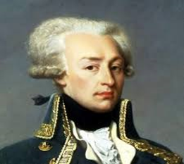
Lafayette was the primary author of the Declaration of the Rights of Man and of the Citizen, which was adopted by the French Revolutionary Assembly in 1789 and which serves as the basic statement of liberty in France to this day.

Slide 5
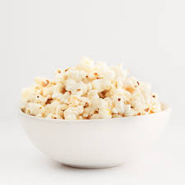
maïs soufflé

Slide 6
If one writes a good CV, one finds a good job.
__________________________________________________________
As soon as they arrive at school they do their history homework.
__________________________________________________________
If we finish before 7 PM we will eat at the Olive Garden.
__________________________________________________________
If Pierre was a fruit he would be a pineapple
__________________________________________________________

Slide 7
Write a sentence with each of the following. Capitalization or lack thereof of the word indicated is irrelevant as to whether or not the word is capitalized in the sentence you write.
lequel _______________________________________________________________________
lesquelles ____________________________________________________________________
auquel_______________________________________________________________________
de laquelle____________________________________________________________________
à laquelle_____________________________________________________________________
desquels_______________________________________________________________________

Slide 8
The doctor died the day when the nurse was born.
__________________________________________________________
The electrician and you sleep in the room where there is a bed.
__________________________________________________________
He is the taxi driver that Margaret Mitchell is scared of.
__________________________________________________________

Slide 9
Devoirs

Slide 10
Billet de sortie
Écrivez une phrase en français, qui parle de votre examen demain.

