Slide 1
Travail de cloche
Write a sentence which uses a direct object pronoun and an indirect object pronoun.

Slide 2
Bonjour!
mardi, le deux avril

Slide 3
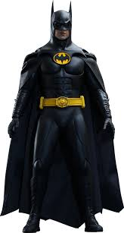
Pourquoi tombons-nous?
Nous tombons pour apprendre comment se lever.

Slide 4
Sommes-nous prêts?
Nous sommes prêts !

Slide 5
The best view of the city of Quebec is from the ferry which crosses the St. Lawrence river from Quebec to Levis

Slide 6
Unit 7 Exam: Friday, April 6.

Slide 7
Write three sentences, each using a different adverb, which describe something you do.
Talk to three other students (none of whom are in the same row as you) and write sentences describing what they do. You must have three different adverbs.

Slide 8
Le passé compsosé avec être
devenir naÎtre je
revenir descender tu
monter entrer elle
sortir retourner nous
venir tomber vous
arriver rester ils
aller mourir
partir passer
rentrer

Slide 9
Write a sentence in the passé composé in which the direct object is plural and masculine.
Rewrite the sentence using a direct object pronoun.

Slide 10
Write a sentence in the passé compose in which the direct object is plural and feminine.
Rewrite the sentence using a direct object pronoun.

Slide 11
Write a sentence which has a direct object and an indirect object.
Replace the COD and the COI with an appropriate pronoun.

Slide 12
Devoirs

Slide 13
Billet de sortie
Draw the flag which shows the order of pronouns for sentences which have both a direct object pronoun and an indirect object pronoun.

