Slide 1
Travail de cloche
Translate into French: I believe that the hippopotamus with the biggest mouth is the one which lives at Jane’s house: I doubt that it is mine.

Slide 2
Bonjour!
vendredi, le douze avril

Slide 3
Vendredi. Vendredi
Rah,rah, rah!
Vendredi, vendredi
On y va!

Slide 4
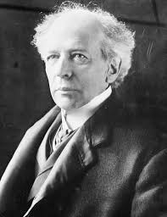
Wilfrid Laurier (1841 – 1919) was the first francophone prime minister of Canada.

Slide 5
Les derniers rois de France

Slide 6
Devoirs

Slide 7
Billet de sortie
What is the best advice you have ever received which can be written as a sentence in the subjunctive?

