Slide 1
Travail de cloche
Translate into French: I will eat lunch tomorrow at Chez Pierre and they will serve Anne and me so quickly that we will return here before fifth period begins.

Slide 2
Bonjour!
mardi, le sept mai
la semaine de reconnaissance des profs

Slide 4
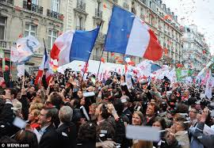
Le huit mai La fête de la victoire

Slide 6
Le futur simple
parler sortir apprendre

Slide 7
le futur simple
quand
dès que

Slide 9
Devoirs

Slide 10
Billet de sortie
Translate into French: When I give a Snickers to Karie, she will love me. As soon as she loves me I will give her five golden rings

