Slide 1
Travail de cloche
Quels sont les derniers mots que M. Hamel a écrit à la fin de la dernière classe?

Slide 2
Bonjour!
lundi, le treize mai

Slide 3
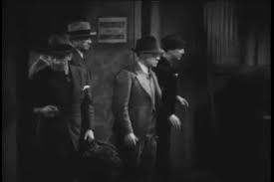
Cherchez la femme!

Slide 4
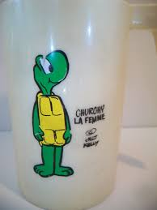
Churchy Lafemme

Slide 5
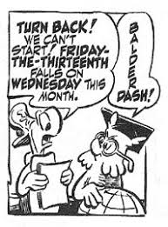

Slide 6
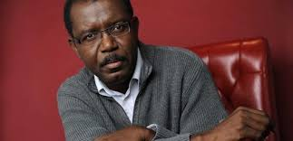
Louis-Phillipe D’Alembert is a Haitian novelist and poet who writes in both French and Haitian Creole

Slide 7
German must be taught in schools in Alsace – Lorrainne
You must not teach anything but German in the schools of Alsace – Lorraine.
It is necessary that Mr. Hamel know how to teach in German if he wishes to continue at the school.
Notes:
ri

Slide 8
La dernière classe

Slide 9
Révision
Unité 5

Slide 10
Billet de sortie
Pourquoi les Allemands pensaient que les Alsatiens n’étaient vraiment pas Francais?

