Slide 1
Travail de cloche
If you were to move into an apartment of your own tomorrow, what would be the three most important rooms, and what would be the most important thing to have in each room?

Slide 2
Bonjour!
mardi, le trois septembre
Un moment de culture francophone
connaitre / savoir

Slide 3
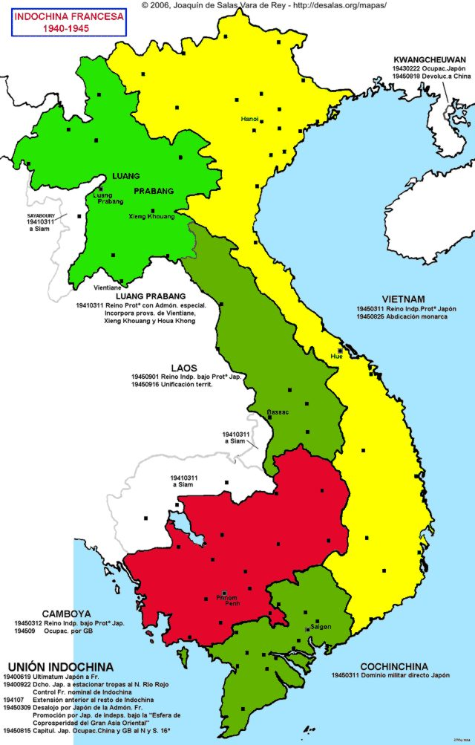
Indochine is a French film which was made in 1962 which tells about the movement in the 1950s to bring about the independence of Vietnam from French colonial rule

Slide 4
connaitre
to know
Used when discussing being acquainted with someone.
Conaissez-vous M. Lovely?
Oui, il enseigne le pre-calc à notre école.
Conaissez-vous Ed Shearan?
Je ne le connais pas, mais je sais qui c’est.

Slide 5
connaitre
to know
Used when discussing familiarity with broad topics.
M. Tullius, connait-il la littérature britannique?
Oui, il connait bien la littérature britannique.

Slide 6
savoir
savoir = to know
Used when discussing specific facts.
Nous savons que notre classe de français commence à 11h25, les jours de bloc.

Slide 7
savoir
savoir = to know
Savoir is never used when speaking of being acquainted with a person, but can be used to give specific facts about someone.
Je sais le nom du chanteur pour Panic! at the disco.
C’est Brendon Urie.

Slide 8
connaitre savoir
je connais nous connaissons je sais nous savons
tu connais vous connaissez tu sais vous savez
il connait elles connaissent il sait elles savent

Slide 9
Je connais _____________. Je sais qu’il / elle __________________.
(une personne)
Nous connaissons _____________. Nous savons que _____________.
(un sujet)

Slide 10
Roman-photo
pp. 22 - 23

Slide 11
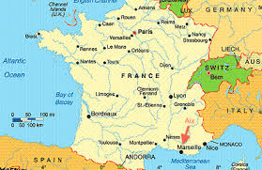

Slide 12
connaitre
savoir

Slide 13
Billet de sortie
Write a sentence indicating that you know someone, and then tell something that you know about that person.

