Slide 1
Travail de cloche
What did you eat for breakfast today?
What is your favorite lunch?
Write a sentence which tells about something which happened while you were eating breakfast today.

Slide 2
Bonjour!
mercredi, le quatre septembre

Slide 3
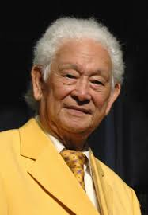
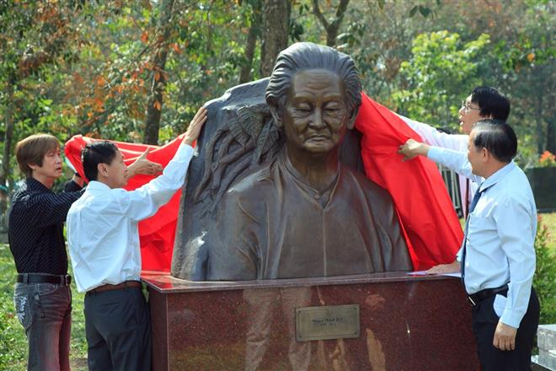
Pham Duy (1921 – 2013) who was born in Vietnam was a francophone poet and songwriter who was exiled for his political views after the end of the American War

Slide 4
Vercingétorix

Slide 5
Roman-photo
pp. 22 - 23

Slide 6
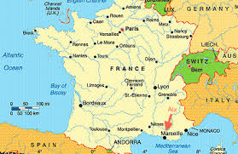
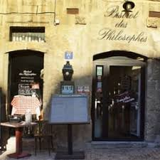

Slide 7
avoir
être

Slide 8
devoirs

Slide 9
Exams: September 17
October15
November 12
December 10
Extra help / Study hall 9th period Monday – Thursday.

Slide 10
Billet de sortie
Write two sentences about Vercingétorix: one in the passé compose using an avoir verb and one in the passé composé using an être verb.

