Slide 1
Travail de cloche
Translate into French: My friend and I talk to each other. You and I meet each other in St. Louis. Jacques and Marie argue with each other all the time.

Slide 2
Bonjour!
mercredi, le six novembre

Slide 3
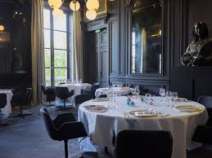
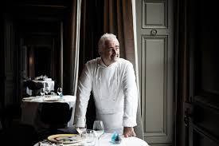
According to an algorithm created by the French government, Le Restaurant Guy Savoy in Paris is the best restaurant in the world.

Slide 4
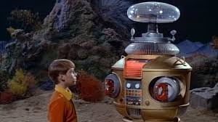
Avertissement! Avertissement! Il y a du danger, Will Robinson!

Slide 5
Unit Exam: Tuesday, November 12

Slide 6
François Ier

Slide 7
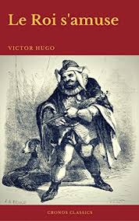

Slide 8
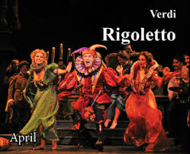

Slide 9
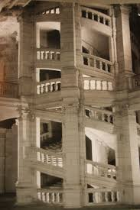
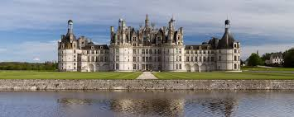

Slide 10
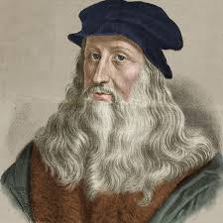

Slide 11
Un matin horrible pour Justin.
Justin se brossait les dents quand soudain…

Slide 12
Devoirs

Slide 13
Billet de sortie
Quand on parle de La Renaissance, de quoi parle-t-on?

