Slide 1
Travail de cloche
aller parler moisir
je
tu
il /elle
nous
vous
elles / ils

Slide 2
Bonjour
mardi, le dix-sept décembre
la dernière classe de 2019
Les années vingt exubérants arriveront
un moment de culture francophone
nous préparons pour l’examen ultime

Slide 3
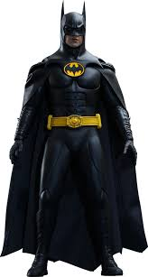
Pourquoi tombons-nous?
Nous tombons pour apprendre comment se lever.

Slide 4
Sommes-nous prêts?
Nous sommes prêts!

Slide 5
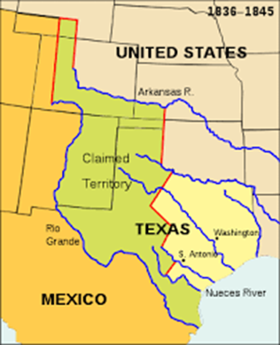
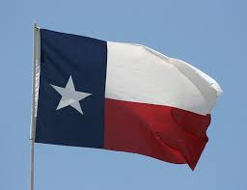
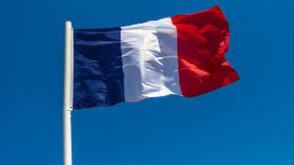
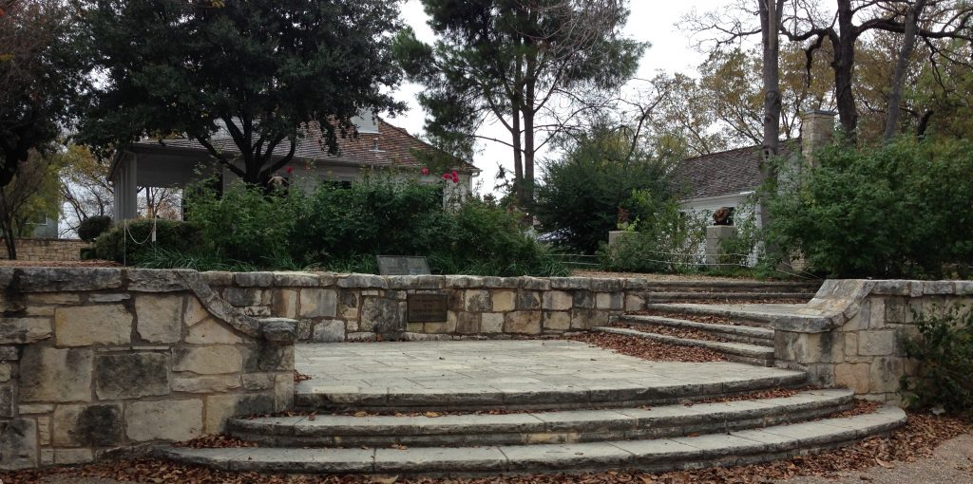
From 1836 -1845, when Texas was an independent republic, France was the only nation which maintained an embassy in Austin.

Slide 6
The final exam, which will be cumulative, will be
Thursday, December 19: 8:53 – 10:33.
There will be quiet study hall in the Babbage Lab, Room 206A, during the morning study hall period (7:45 – 8:47) Wednesday, Thursday, and Friday of finals week. M. Gerson will be available to answer questions during this time.
If you finish taking the test before the end of the test period, you will be allowed to go to another room only if you have a pass from a teacher.

Slide 7
How many stores are in the city?
____________________________________________________________________________
Where is the classroom of Mrs. Salehi?
____________________________________________________________________________
At what time does art class begin?
____________________________________________________________________________
Who is the best (meilleur) singer (chanteur) in the world (du monde)?
____________________________________________________________________________
Why do you eat fish?
_____________________________________________________________________________
Marcel and Bertrand eat croissants at the restaurant.
_________________________________________________________________________
You (familiar) take three cinnamon rolls after school.
_________________________________________________________________________
I do not have sugar.
___________________________________________________________________________
We eat chicken every Friday.
___________________________________________________________________________
Their cousins (feminine) drink cold drinks at dinner.
____________________________________________________________________________

Slide 8
Billet de sortie
Write a complete sentence of at least five words in French.

