Slide 1
Travail de cloche
Translate into French, replacing the direct object and indirect object with appropriate pronouns, and making any other changes which might be necessary: Louise sent five chickens to those of us who like KFC.

Slide 2
Bonjour!
vendredi, le huit mai

Slide 3
Vendredi, vendred
Rah, rah, rah!
Vendredi, vendredi
On y va!

Slide 4
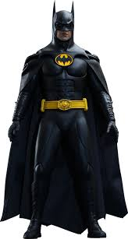
Pourquoi tombons-nous?
Nous tombons pour apprendre comment se lever.

Slide 5
Sommes-nous prêts?
Nous sommes prêts !

Slide 6
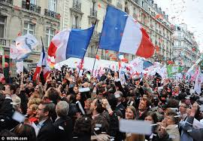
Le huit mai La fête de la victoire

Slide 8
les saisons
Que faites-vous pendant les saisons ?
Expressions with faire.
Il faut / Il ne faut pas

Slide 9
finir
finir = to finish
je nous
tu vous
il elles

Slide 10
giving , telling, showing

Slide 11
There is no written homework assignment which is due Monday, but you are encouraged to review the work which was covered during this semester and to bring any questions you might have for discussion during class.

Slide 12
Billet de sortie
Write a sentence which uses the imparfait and the passé composé which talks about your experiences in French 1.

