Slide 1
Travail de cloche
Écrivez une phrase au subjonctif qui ne commence ni “Je suis triste…” ni “Je suis heureu(x)(se)...”

Slide 2
Bonjour!
lundi, le douze mai

Slide 3
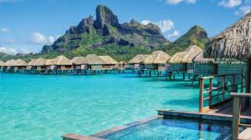
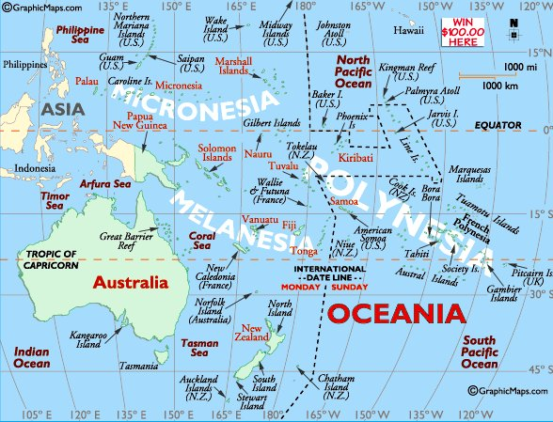
The day of the francophone world ends in Bora Bora, the western-most island of French Polynesia.

Slide 4
The final exam will be distributed as an assignment via Google Classroom on Wednesday, May 13.
The assignment will be scheduled for distribution at 8:55 AM.
You will have until noon to complete the exam.
You will not be required to log on to Zoom to take the exam. M. Gerson will be in the “Zoom Room” until 9:30 AM to answer questions. After that time email sgerson@libertycommon.org if you have questions, concerns, or problems.

Slide 5
The final exam will follow the same format as the previous tests. There will be translation as well as questions which ask you to write sentences using a specific word or which ask for a sentence about a historical figure discussed in class. The exam will be focused on what has been covered during the second semester, but as always, anything which you are reasonably expected to know as a student completing French 2 might be needed to answer a question correctly.

Slide 6
Questions concerning the final exam?

Slide 7
La dernière classe

Slide 8
Vous êtes Franz. La dernière classe est finie. Vous avez l’occasion de dire une seul phrase à M. Hamel avant que vous vous en alliez. Que dites vous ?

Slide 9
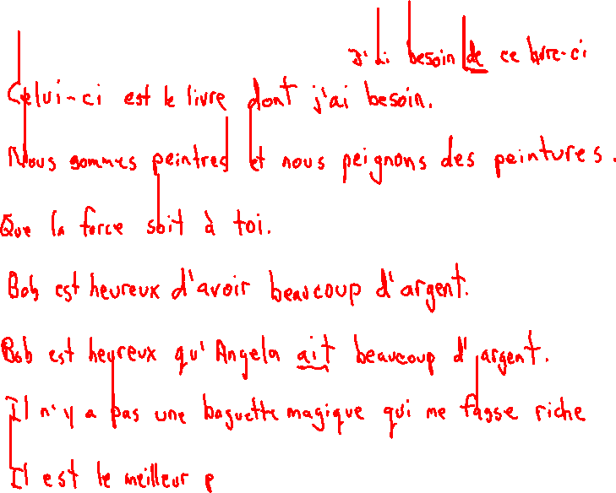
That is the book I need.
We are painters and we paint paintings.
May the force be with you.
Bob is happy to have a lot of money.
Bob is happy that Angela has a lot of money.
There is no magic magic wand which will make me rich.
He is the best teacher we know who comes from Brooklyn.
There is nothing which Claude has to do.

Slide 10
La Fin

