Slide 1
Turn in your homewok!!!
Travail de cloche
Use the questions / answers handouts to answer the question: Comment vous appelez-vous?

Slide 2
Bonjour! Lesson 2: D’Accord pp. 2, 3, 14
mardi, le vingt-trois août
un moment de culture francophone
introductions
counting
The students will learn to count to ten in French.

Slide 3
Pourquoi tombons-nous?
Nous tombons pour apprendre comment se lever.

Slide 4
Sommes-nous prêts?
Nous sommes prêts !

Slide 5
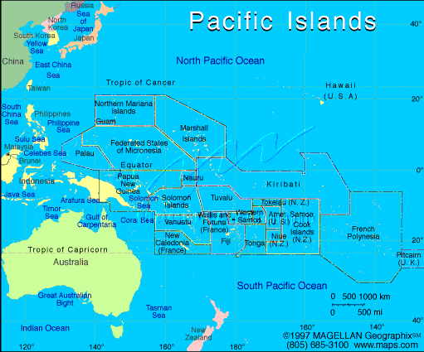
The day of the francophone world begins in Wallis and Futuna

Slide 6
What is your name?
What is your grade level?
How many years have you been at Liberty Common? (elementary and high school combined)
Why are you taking French?
Tell us something about yourself.
Ask a question of M. Gerson.

Slide 7
1 un
2 deux
3 trois
4 quatre
5 cinq
six
sept
huit
neuf
dix

Slide 8
La révision
Where does the day of the franconphone world begin?
Pourquoi tombons-nous?
Comptez d’un à dix.

Slide 9
Devoirs

Slide 10
Billet de sortie
Write out two questions in French, and then write the answers.

