Slide 1
Bonjour!
mercredi, le cinq octobre

Slide 2
Travail de cloche
Dites quelque chose du roi Saint-Louis.

Slide 3
Bonjour!
mercredi, le cinq octobre
un moment de culture francophone
avertissement
Le roi Saint-Louis

Slide 4
Avertissement!
Examen: Friday, October 7
le passé recent
Les verbes vouloir, pouvoir, devoir
comparatives and superlatives of adjectives and adverbs
Vocabulary: les petits commerçants, la nourriture, sur la table
Any other material which has been covered in French 1 and / or French 2

Slide 5
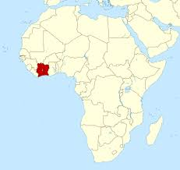
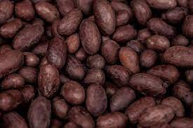
The francophone nation of Côte d’Ivoire is the world’s largest exporter of cocoa beans.

Slide 6
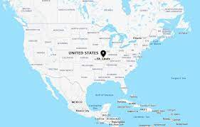
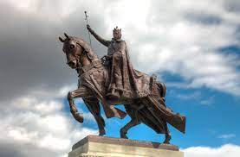
Le roi Saint-Louis

Slide 7
Write a sentence using devoir + an infinitive, one using devoir without an infinitive, and one using devoir as a noun. Write a sentence using pouvoir + an infinitive in the imparfait and one in the passé composé. Write a sentence using vouloir + the infinitive of an “être” verb.

Slide 8
Devoirs

Slide 9
Billet de sortie
Write three sentences, one each in which the verb pouvoir, vouloir, and devoir are followed by an infinitive. The three infinitive must all be different. The subject of each sentence must have a different person and number.

