Slide 1
Bonjour!
lundi, le vingt-quatre octobre

Slide 2
Travail de cloche
Quelles sont trois choses qui sont sur votre bureau chez vous?
Oui, vous avez un bureau chez vous!

Slide 3
Bonjour!
lundi, le vingt-quatre octobre
une annonce
un moment de culture francophone
la révision
décrivez la sculpture
The students will be able to use prepositions to describe where things are located.

Slide 4
Pourquoi tombons-nous?
Nous tombons pour apprendre comment se lever.

Slide 5
Sommes-nous prêts?
Nous sommes prêts !

Slide 6
If you would like M. Gerson to review your homework which is due the next day, bring it to ninth period.
Your work will be marked without comment or correction. You may then turn in your corrected work the next day with no penalty for it having been previously marked.
If you turn in corrected work, it may be done on a new sheet of paper, but all information which was on the original homework handout must be on the paper you hand in.

Slide 7
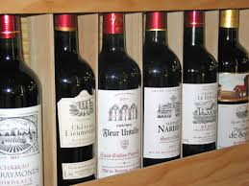
There are over 300 wine-producing regions in France which can claim an Appellation d’Origine Contrôllée

Slide 8
p. 120
sur
sous
dans
devant
derrière
à droite
à gauche
avec

Slide 9
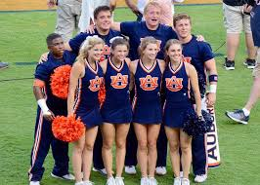
meneuse de claque / meneur de claque

Slide 10
Chez is a preposition!!!!
It is not a noun.

Slide 11
If you are in an odd-numbered row, turn your desk to the left. If you are in an even numbered row turn your desk to the right.
You are now the partner of the person you are facing.
Decide which partner will build a sculpture and which person will draw it.
Set up a barrier which prevents the draw partner from seeing what the build partner is doing.
Make a sculpture by arranging five or six things on your table.
Describe the sculpture using appropriate prepositions.
The draw partner will attempt to draw a picture of the sculpture from the description given.

Slide 12
Marcel est Maurice sont frères.
Antoine est le petit-fils de Marcel.
Louise est la petite-fille de Maurice.
Quelle est la relation entre Louise et Antoine?
Ils sont des cousins issue de germain.
Le fils de Marcel et la fille de Louise sont cousins germain au deuxième degré.

Slide 13
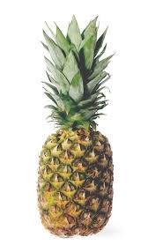
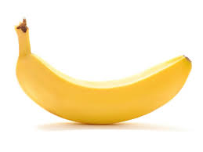
Les pronoms disjoints suivent les prepositions.
La banane est à droite de l’ananas.
Elle est à droite de lui.
Elle est à sa droite.

Slide 14
les pronoms disjoints
1st person singular moi
2nd person singular toi
3rd person singular (m) lui
3rd person singular (f) elle
1st person plural nous
2nd person plural vous
3rd person plural (f) elles
3rd person singular (m) eux

Slide 15
Les pronoms disjoints are also used to add emphasis when speaking about the subect of a sentence.
Moi, je déteste cette école à Tuscaloosa.
Lui, il habite un ananas sous-marin.
Les disjoints are also used when more than one subject pronoun is used in a sentence.
Moi et toi sommes les meilleurs amis.

Slide 16
My elephant is under Ralph’s bed.
My sister hides her candy in Clothilde’s backpack.
His brother is to the left of them (masculine)
Their grand-daughters are far from Paris.
My neighbor is a widow.

Slide 17
en face de
entre
loin de
près de
à côté de
en haut
en bas

Slide 18
Devoirs

Slide 19
Billet de sortie
Translate into French: The pen of my aunt is on the desk of my uncle.

