Slide 1
Bonjour
lundi, le cinq décembre

Slide 2
Travail de cloche
Write a sentence of at least five words which uses a regular “IR” verb.

Slide 3
Bonjour
lundi, le cinq décembre
un moment de culture francophone
Nous faisons des phrases.

Slide 4
Pourquoi tombons-nous?
Nous tombons pour apprendre comment se lever.

Slide 5
Sommes-nous prêts?
Nous sommes prêts!

Slide 6
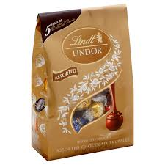
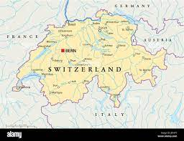
Selon beaucoup de gens, le meilleur chocolat du monde est produit en Suisse.

Slide 7
Unit 4 exam:
Friday, December 9.
The final exam, which will be cumulative, will be
Wednesday, December 15: 9:40 AM – 10:20 AM.
You are invited to study hall in this room (205A) from 2:00 – 2:45 Wednesday and Thursday.

Slide 8
Write sentences of at least five words in French, each using the word in parentheses somewhere in the sentence. If the word is a verb it may be used in any proper conjugation or in the infinitive.
(la piscine)
(jouer)
(comment)
(le centre commercial)
(finir)

Slide 9
Write sentences in the futur proche (aller + infinitive) using the subject indicated in parentheses and at least five additional words. You must use five different infinitives.
(Bertrand et Claude)
(Tu et M. Arnaud)
(Toi et moi)
(Mme Peyrac)
(Je)

Slide 10
Change the statement below into a question using the methods indicated.
Vous aimez les castors.
Tag phrase
Est-ce que
Inversion

Slide 11
Write the following times in words using twenty-four hour time.
9:30 PM _________________________________________________
10:15 AM ________________________________________________
1:58 PM _________________________________________________
1:45 AM _________________________________________________

Slide 12
Devoirs

Slide 13
Billet de sortie
Describe what is to your left.

