Slide 1
Bonjour
mardi, le six décembre

Slide 2
Travail de cloche
Moisir is a regular “IR” verb which means to become moldy. Write a sentence of at least five words, in French, which uses the verb moisir.

Slide 3
Bonjour
mardi, le six décembre
quel jour de fête
un moment de culture francophone
Nous préparons pour l’examen

Slide 4
Pourquoi tombons-nous?
Nous tombons pour apprendre comment se lever.

Slide 5
Sommes-nous prêts?
Nous sommes prêts!

Slide 6
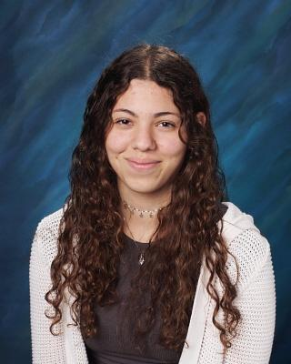
Bon anniversaire
Bon anniversaire
Bon anniversaire
Bon anniversaire Manuela
Bon anniversaire

Slide 7
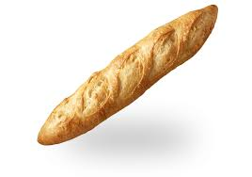
The French baguette has been added to UNESCO's 'intangible cultural heritage' list

Slide 8
Unit 4 exam:
Friday, December 10.
The final exam, which will be cumulative, will be
Wednesday, December 15: 7:45 AM – 9:30 AM.
You are invited to study hall in this room (206A) from 2:00 – 2:45 Wednesday and Thursday.

Slide 9
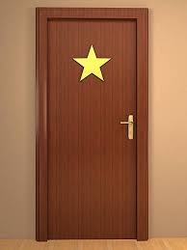
Je vais devenir une vedette!

Slide 10
(grossir)
(choisir)
(grandir)
(obéir à)
(finir)

Slide 11
You (familiar) drink three glasses (verres) of milk after school.
I do not take sugar in my tea.
We eat an eclair every Friday.
Their cousins (feminine) drink lemonade.

Slide 12
Write the following times in words using twenty-four hour time.
9:30 PM _________________________________________________
10:15 AM ________________________________________________
1:58 PM _________________________________________________
1:45 AM _________________________________________________

Slide 13
Devoirs

Slide 14
Billet de sortie
What will you choose to do today?

