Slide 1
Bonjour!
lundi, le treize février

Slide 2
Travail de cloche
Translate into French: Justin is wearing black pants, a white shirt, and a green tie.

Slide 3
Bonjour!
lundi, le treize février
un moment de culture francophone
le défilé de mode

Slide 4
Pourquoi tombons-nous?
Nous tombons pour apprendre comment se lever.

Slide 5
Sommes-nous prêts?
Nous sommes prêts !

Slide 6
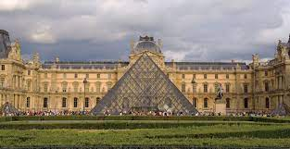
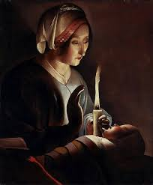
Le Musée du Louvre in Paris houses most of the known surviving paintings of Geroges de La Tour

Slide 7
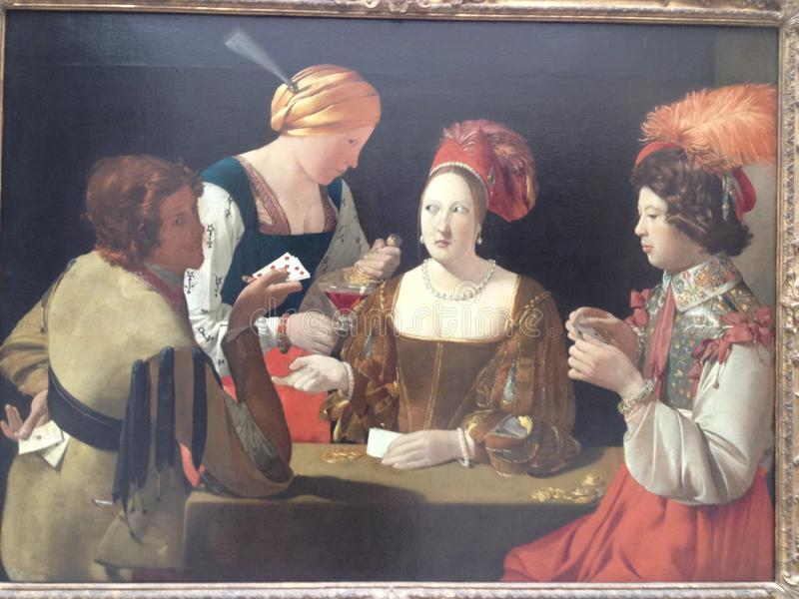

Slide 8
Choose a partner.
Each of you will write out a description of what the other is wearing.
Each of you will the model your outfit while the other reads (or recites) the description.
You must mention at least three items of apparel and their color(s)
Feel free to use as many adjectives as part of your descriptions of the clothing and the model.
You may mention the designer / brand / origin of an item.

Slide 9
In-class writing assignment: Tomorrow, Tuesday, February 14
La Saint-Valentin de Justin
You will write a story of at least seven sentence which tells how Justin spent (or will spend ) Valentine’s Day
You may make this a story of romance, a story of despair, or anything in between.
Your story must be entirely in French.
You will have 20 minutes to write your story.

Slide 10
Devoirs

Slide 11
Billet de sortie
Answer the following question with a complete sentence: Quel était le meilleur ensemble (pas le vôtre ou celui dont vous avez parlé) que vous avez vu aujourd’hui. Il faut décrire les vêtements: vous ne pouvez pas dire simplement “celui de Justin.”
Souvenez-vous! Il faut écrire des phrases completes!

