Slide 1
Bonjour!
mardi, le vingt et un mars

Slide 2
Travail de cloche
Translate into French: Sophia and Margot went to the store. When they arrived they fell down. It rained. They cried.

Slide 3
Bonjour!
mardi, le vingt et un mars
la meilleure littérature du monde!
The students will appreciate great literature.

Slide 4
Pourquoi tombons-nous?
Nous tombons pour apprendre comment se lever.

Slide 5
Sommes-nous prêts?
Nous sommes prêts !

Slide 6
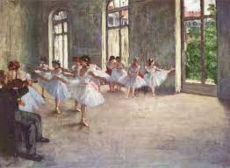
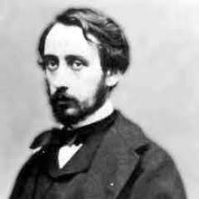
Edgar Degas (1834 – 1917) is well known for his paintings of ballet dancers.

Slide 7
L’imparfait is used to describe actions from the past
which were on-going events or habitudes
which describe emotions
which describe the weather
which set the background for a story
which describe an action which was interrupted by a second event.
which describe simultaneous actions in the past.

Slide 8
The passé compose is used to describe events in the past…
…which happened once and were completed.
…which are a series of events which happened one after the other, usually with each being responsible for the one which follows.
…interrupted an ongoing action of the past, sometimes introduced by terms such as “soudain” or “tout à coup”.

Slide 9
L’imparfait is used to describe actions from the past
which describe simultaneous actions in the past.
Jean mangeait une pomme pendant que Marie buvait du lait.

Slide 10
L’imparfait is used to describe actions from the past
which describe an action which was interrupted by a second event.
The interrupting event is in the passé compose.
Je chantais “Frère Jaques” quand mon chien a commencé à hurler.

Slide 11
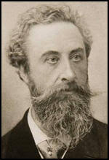
Sir Edward Bullwer-Lytton
(1803 – 1873)
Paul Clifford

Slide 12
It was a dark and stormy night; the rain fell in torrents—except at occasional intervals, when it was checked by a violent gust of wind which swept up the streets (for it is in London that our scene lies), rattling along the housetops, and fiercely agitating the scanty flame of the lamps that struggled against the darkness.

Slide 13
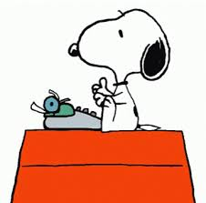

Slide 14
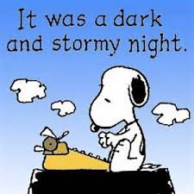

Slide 15
Hôtel Paradis
p. 285

Slide 16
les verbes “ER” je
les verbes “IR” tu
les verbes “RE” elle / il
les verbes irregulier. nous
vous
ils / elles

Slide 17
alors
après
avant
d’abord
donc
enfin
ensuite
finalement
pendant
puis
tout à coup
tout de suite

Slide 18
Devoirs

Slide 19
Billet de sortie
Translate into French: It was a dark, stormy night.
Notes:
é

