Slide 1
Bonjour
lundi, le vingt novembre.

Slide 2
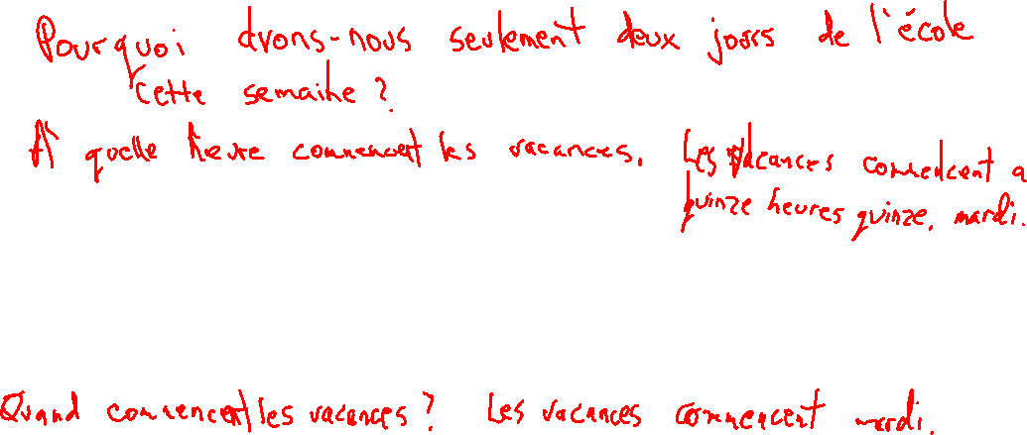
Travail de cloche
Write a question (in French) which begins with an interrogative word and which concerns the fact that we will only be in school two days this week.

Slide 3
Bonjour
lundi, le vingt novembre.
un moment de culture francophone
Les cafés

Slide 4
Pourquoi tombons-nous?
Nous tombons pour apprendre comment se lever.

Slide 5
Sommes-nous prêts?
Nous sommes prêts!

Slide 6
Vango : Between Sky and Earth, by Timothée de Fombelle, is currently a best-selling book in France.

Slide 7
Read “Le Café français” and “Les Cafés nord-africains” pp. 158 – 159.
Write (in French) five sentences about French cafés and five sentences about North African cafés.
Read “Des spécialités à grignoter*” on p.159. Choose one of the dishes which is listed there and write a sentence in French where you declare it to be your favorite, giving a reason. Then wirte four sentences, each of which begins with a different interrogative word, which are related to your food item.
* Grignoter = snack / light meal

Slide 9
Write sentences of at least five words in French, each using the word in parentheses somewhere in the sentence. If the word is a verb it may be used in any proper conjugation or in the infinitive.
(la piscine)___________________________________________________________
(jouer)______________________________________________________________
(comment)__________________________________________________________
(le centre commercial)_________________________________________________
(finir)_______________________________________________________________

Slide 10
Devoirs

Slide 11
Billet de sortie
Quelle est la chose que vous aimez grignoter après l’école?

