Slide 1
Bonjour!
mardi, le vingt-sept février

Slide 2
Travail de cloche
Translate into French: I like to visit Paris in the springtime.

Slide 3
Bonjour!
mardi, le vingt-sept février
un moment de culture francophone
avertissement
révision

Slide 4
Pourquoi tombons-nous?
Nous tombons pour apprendre comment se lever.

Slide 5
Sommes-nous prêts?
Nous sommes prêts !

Slide 6
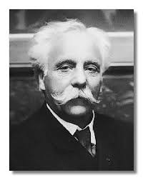
The music of French composer Gabriel Fauré (1845 – 1924) has been described as a bridge between XIXème century romanticism and XXème century modernism.

Slide 7
AVERTISSEMENT
Examen
Unité 6 etc.
Friday, March 1

Slide 8
She gave us an inexpensive gift.
Yesterday, I spoke to Claire.
I visited Paris where I visited Jeanne Moreau, and she returned my book to me.
I took a pen from Justin, then I put a pencil on the blue table.
I translated the book.
Today I am wearing a gray shirt, blue pants, and black socks.
During (Pendant) my youth, I ate pineapple every Saturday

Slide 9
Devoirs

Slide 10
Billet de sortie
Translate into French. I wait for Madeleine to the left of the movie theatre.
Notes:
É.

