Slide 1
Bonjour
vendredi, le vingt-trois février

Slide 2
Travail de cloche
Translate into French: Mathilde goes down to the basement. Jacques carries two kilos of potatoes down to the basement.

Slide 3
vendredi, le vingt-trois février

Slide 4
Vendredi, vendredi
Rah, rah, rah!
Vendredi, vendredi
On y va!

Slide 5
vendredi, le vingt-trois février
un moment de culture francophone
Avertissement!

Slide 6
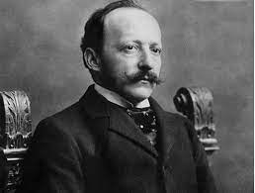
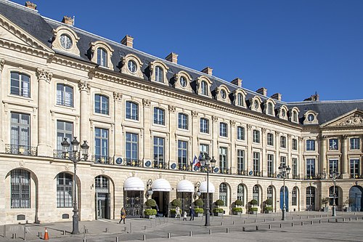
Cesar Ritz was a Swiss francophone hotelier whose insistence on quality and service have made his name synonymous with luxury and elegance.

Slide 7
AVERTISSEMENT!
Examen
Unité 6
Friday, March 1

Slide 8
I wait for Madeleine who sings.
We gave them this computer.
Tuesday, I drove a blue car when I took Justin to Denver.
Yesterday, Marie put the cookies on the table.
Louis and Bertrand took three cakes to the party.

Slide 9
La Maghreb
pp. 258 - 259

Slide 10
Devoirs

Slide 11
Billet de sortie
Write, in French, a sentence which tells something you learned today.

