Slide 1
Bonjour!
mercredi, le vingt mars

Slide 2
Travail de cloche
Translate into French: Yesterday, I was singing “Shake it Off*” when suddenly I saw Taylor Swift who was dancing to the music.
*Secouez-le hors

Slide 3
Bonjour!
mercredi, le vingt mars
un moment de culture francophone
Sentences which use the imparfait and the passé composé and sentences which do not.
trois verbes fantastiques
un conte de fée.
The students will consolidate thier knowledge of the idea of an interrupting past action, and will then show their love for the verbs dire, lire, and écrire

Slide 4
Pourquoi tombons-nous?
Nous tombons pour apprendre comment se lever.

Slide 5
Sommes-nous prêts?
Nous sommes prêts !

Slide 6
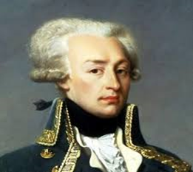
Le Marquis de Lafayette s’est battu à quelques batailles importantes de la révolution américaine, y compris Yorktown.

Slide 7
When an ongoing activity in the past is interrupted by a second past activity which happens suddenly, the original ongoing activity is conjugated in the imparfait the interrupting activity is conjugated in the passé compose.
I was singing when my dog began to bark.
Je chantais quand mon chien a commencé à aboyer.
The interrupting action must begin to happen while the original action is taking place.

Slide 8
The use of quand, soudain, tout à coup indicate an interruption, meaning that the imparfait / passé composé sequence should be used.

Slide 9
If the two actions were happening at the same time, both must be in the imparfait.
I was singing while my dog was barking.
Je chantais pendant que mon chien aboyait.
Pendant indicates that the activities are simulataneous and that both should be in the imparfait.

Slide 10
If one action took place and a second (which did not happen simultaneously to the first) took place at a later time, one uses the plus que parfait, which is not covered until French 3.
I had been singing, and later my dog was barking.
J’avais chanté et puis mon chien aboyait.
The use of puis, plus tard, alors indicates that the plus que parfait is used.

Slide 11
A series of actions which follow one after another are all in the passé compose.
I walked to school, I talked to my friend, I entered the classroom, I opened my notebook.
J’ai marché à l’école, j’ai parlé à mon amie, je suis entré la salle de classe, j’ai ouvert mon cahier.

Slide 12
If an action took place during a defined period of time, it is described in the passé composé.
La deuxième guerre mondiale en Europe a duré du premier septembre 1939 au huit mai 1945.
Lacking a defining time period, a long-lasting event is described in the impafait.
La deuxième guerre mondiale durait jusqu’aux Allemands se sont rendus.

Slide 13
A passive verb (e.g. to wait, to look, to see) should be in the imparfait, even when it is part of a sequence of events.
Clothilde est partie pour l’école, elle regardait la rue, elle a traversé la rue, elle est tombée.

Slide 14
A description of a change or start of a weather event or an emotion is introduced by a a verb such as commencer or devenir follower by an infinitive.
A midi, il a commencé à neiger.
Quand il a appris que son chien était malade, il est devenu triste, et il était triste jusqu’au jour quand sa marrain fée a guéri le chien avec sa baguette magique.

Slide 15
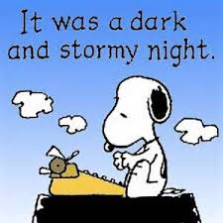

Slide 16
dire = to say
je dis nous disons
tu dis vous dites
elle dit ils disent
past participle = dit

Slide 17
lire = to read
je lis nous lisons
tu lis vous lisez
elle lit ils lisent
past participle = lu

Slide 18
elle lit
le lit

Slide 19
Il lit au lit

Slide 20
écrire = to write
j’écris nous écrivons
tu écris vous écrivez
elle écrit ils écrivent
past participle = écrit

Slide 21
Il était une fois

Slide 22
Devoirs

Slide 23
Billet de sortie
Translate into French: We ate dinner, I wrote a letter to Bob, I said “I like your pineapple.”

