Slide 1
Bonjour!
jeudi, le vingt et un mars

Slide 2
Travail de cloche
Write a sentence which uses the past tense of the subjunctive and which talks about a dog.

Slide 3
Bonjour!
jeudi, le vingt et un mars

Slide 4
Lafayette was the primary author of the Declaration of the Rights of Man and of the Citizen, which was adopted by the French Revolutionary Assembly in 1789 and which serves as the basic statement of liberty in France to this day.

Slide 5
Antoine de Saint-Exupérey

Slide 6
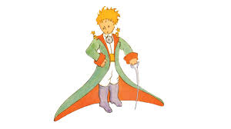
Le Petit Prince

Slide 7
Devoirs

Slide 8
Billet de sortie
Selon le lecture du Petit Prince, que fait un géographe et qu’est-ce qu’il ne fait jamais?

