Slide 1
Bonjour!
vendredi, le vingt-deux mars

Slide 2
Travail de cloche
Translate into French: Justin is sad that his neighbor Ann is lazy.

Slide 3
Bonjour!
vendredi, le vingt-deux mars

Slide 4
Vendredi, vendredi
Rah, rah, rah!
Vendredi, vendredi
On y va!

Slide 5
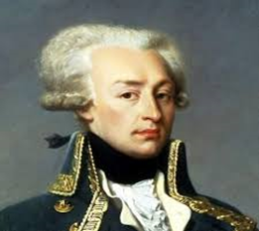
When the first American troops arrived in France to fight during World War I, Col. Charles Stanton tried to say in French “Lafayette, we are here!” but actually spouted ungrammatical gibberish.

Slide 6
Ouvrez votre livre à pp. 328 – 329.
Écrivez cinq questions pour lesquelles on peut trouvez les réponses dans la lecture.

Slide 7
Demonstrative pronouns (celui, celle, ceux, celles) must be followed by
prepositional phrase, relative pronoun, the words ci or là.
Le stylo le plus important est celui avec lequel…
Celle-ci (Celle-là) est la femme qui possède trente vaches.
Celle qui a trente vaches a beaucoup de lait.

Slide 8
You (formal) think that Paris is the biggest city in France.
Harry believes that we do the cooking at the restaurant.
They doubt that you (familiar) read books like Moby Dick.
Arthur do not believe that Imogen has Edwyn’s book.
My dog has more fleas (puce f) than Juno.
This band has fewer musicians than the Fort Collins Symphony.

Slide 9
Jacques has as many horses as Laurent.
I wish you a Merry Christmas.
John and Robert are astonished that you do the cooking at your house.
Your (familiar) house (domus) earned more points for the Neenan Cup than DF.

Slide 10
Devoirs

Slide 11
Billet de sortie
Write a sentence about LCHS which uses the word “autant”.

