Slide 1
Bonjour!
mercredi, le vingt-sept mars

Slide 2
Travail de cloche
Write a sentence which uses two different adverbs.
Notes:
é

Slide 3
Bonjour!
mercredi, le vingt-sept mars
un moment de culture francophone
avertissement
panorama
révision
The students will compete for the admiration of their teacher by displaying their knowledge of francophone culture.

Slide 4
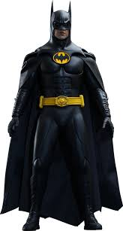
Pourquoi tombons-nous?
Nous tombons pour apprendre comment se lever.

Slide 5
Sommes-nous prêts?
Nous sommes prêts !

Slide 6
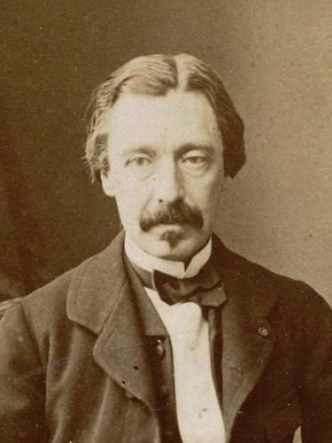
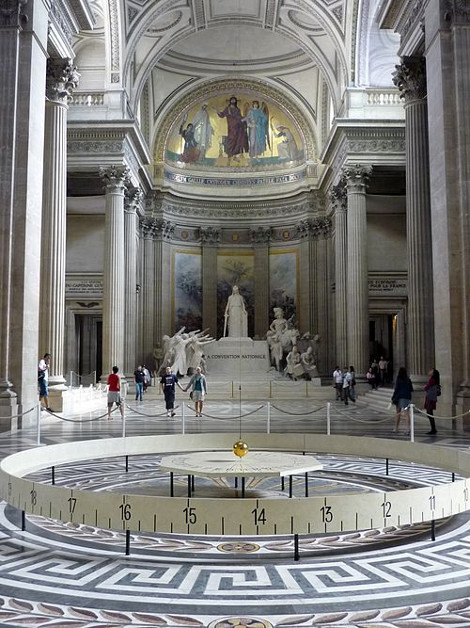
Léon Foucault was a French physicist who, in 1851, displayed a pendulum which can be used to demonstrate that the earth rotates around its axis.

Slide 8
Panorama
pp. 302 - 303

Slide 9
aérobique alphabet

Slide 10
la musique
Au fond du temple saint

Slide 11
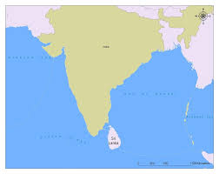

Slide 12
Les Pecheurs de perles

Slide 13
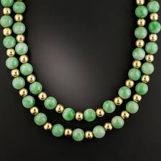

Slide 14
On parle français!!!

Slide 15
Carol was reading while Alice was writing.
We run rapidly at the park.
You and your mother often say “we like pineapples.”
It was raining when his plane arrived at the airport.
We wrote our letters to Santa Claus last Saturday

Slide 16
Devoirs

Slide 17
Billet de sortie
Translate into French: We walked to school, we entered the building, we heard the school song, we ran to class*, we listened to the teacher.
*Never run to class!
Notes:
é

