Slide 1
lundi, le quinze avril

Slide 2
Travail de cloche
Écrivez une phrase au subjontif qui parle du roman-photo.

Slide 3
lundi, le quinze avril

Slide 4
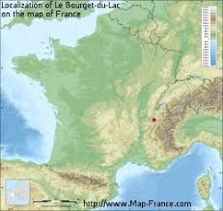
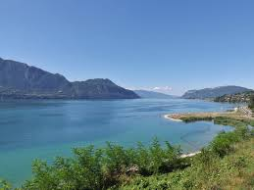
Le Lac de Bourget is the largest lake in France

Slide 5
Roman-photo
340 - 341

Slide 6
Although Lucie drinks a lot of milk, she is always thirsty.
_________________________________________________________________________
In order that my grandson becomes a doctor, he studies biology in high school.
_________________________________________________________________________
Unless you and your boyfriend have enough potatoes, you cannot feed the elephants.
_________________________________________________________________________
Jean is the best poet who writes for the theater.
_________________________________________________________________________
I do not know anyone who makes good bouillabaisse.
_________________________________________________________________________
There is nothing that could help me.
_________________________________________________________________________

Slide 7
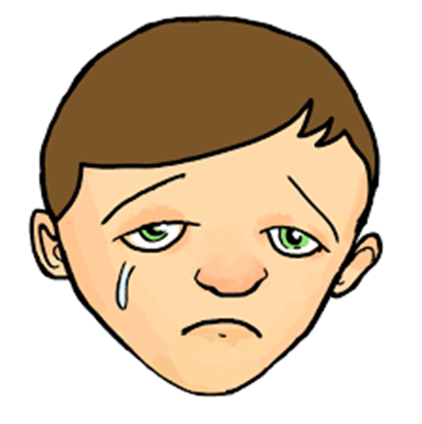

Slide 8
Devoirs

Slide 9
Billet de sortie
Write a sentence in French about your own life which begins “Afin que je…” and which uses the subjunctive.

