Slide 1
Bonjour!
mercredi, le dix-sept avril

Slide 2
Travail de cloche
Qui débarrasse la table après le diner chez-vous?

Slide 3
Bonjour!
jeudi, le vingt avril
un moment de culture francophone
une histoire

Slide 4
Pourquoi tombons-nous?
Nous tombons pour apprendre comment se lever.

Slide 5
Sommes-nous prêts?
Nous sommes prêts !

Slide 6
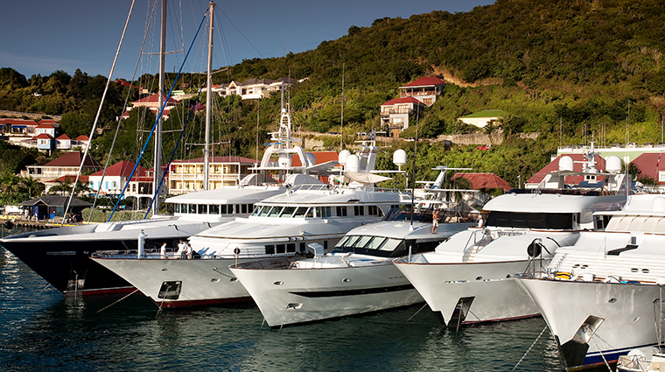
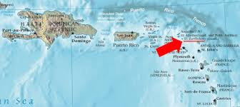
The French Caribbean island of Saint-Barthelemy is famous as a winter vacation destination for very rich people.

Slide 7
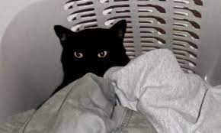

Slide 9
When she was fifteen years old, she cleared the table at her uncle’s house.
___________________________________________________________________
We were clearing the table when the cat died.
___________________________________________________________________
Yesterday, I swept the floor at 6:00 PM.
___________________________________________________________________
At the start of the morning André made his bed, and at the end of the day, Marie and Claire sang the school song.
___________________________________________________________________
Please tidy up the living room and clean the kitchen.
________________________________________________________________
On Monday, April 19, Jacques went to a house with a rug which was very clean.
_________________________________________________________________

Slide 10
Devoirs

Slide 11
Billet de sortie
Translate into French: The bathroom sink, which is to the right of the door, is dirty.

