Slide 1
Bonjour!
mardi, le vingt-trois avril

Slide 2
Travail de cloche
You do not wish to do your least favorite household chore. Who will you ask to do it in your place, what will you offer him / her to do it, and why do you think (s)he will accept?

Slide 3
Sommes-nous prêts?
Nous sommes prêts !

Slide 4
Bonjour!
mardi, le vingt-trois avril
un moment de culture francophone
les levres fous
le château de Versailles
révision de connaitre / savoir

Slide 5
Pourquoi tombons-nous?
Nous tombons pour apprendre comment se lever.

Slide 6
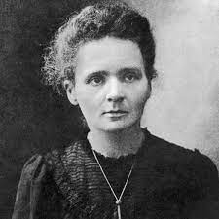
Marie Curie, who was born in Poland but whose entire scientific career was in France, is the only person to have won the Nobel Prize in both chemistry and physics.

Slide 7
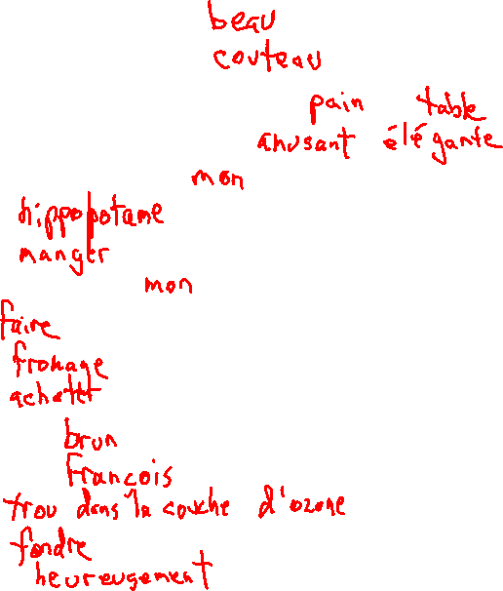
BANGS Adjective
noun
2 nouns (masculin et feminin)
Deux adjectifs non-BANGS
Possessive adjective
noun
verbe
adjectif possessif
verb
nom
verbe
Adjective
First Name
Noun
Verb
adverb

Slide 8
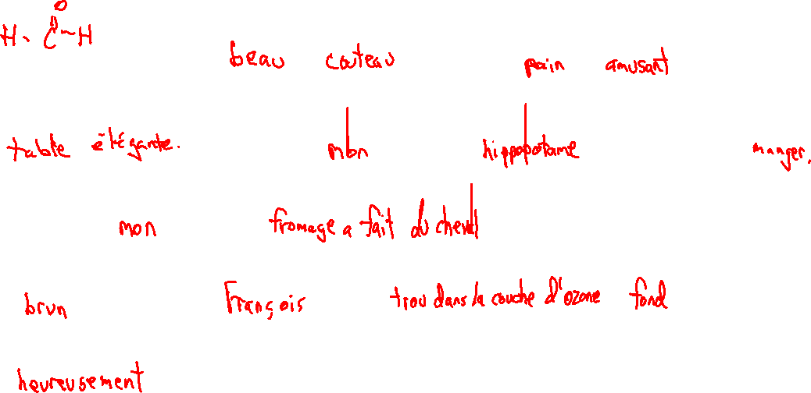
Il était une fois une (adjectif) (nom) . Il avait un (nom) (adjectif) et une
(nom) (adjectif). Un jour, (adjectif possessif) (nom) a commencé à (verbe).
Ensuite, (adjectif possessif) (nom) (verbe). Maintenant, il est
_(adjectif)__car __(prénom)__ a _un (nom)___ qui _(verbe)__
(adverbe)__.
.

Slide 9
I know who is the French teacher at LCHS.
You (familiar) know about pretty flowers.
Emily knows how to vacuum the rug.
André and I know Mrs. Foulard, the woman who ate the fish.
You (formal) know how to write a funny story.
They know who has the worst toaster.

Slide 10
Write out four questions (in French) which are based on the reading about the Château de Versailles (pp. 350 – 351) which was assigned as homework last week.
The answers to your questions must be information which can be found in the textbook.
You will be asking these questions as part of a competition with other groups, so it is probably best to not use the same questions which were asked for homework.

Slide 11
Devoirs

Slide 12
Billet de sortie
Translate into French: Yesterday I used my broom to clean the kitchen and to play quidditch.

