Slide 1
Bonjour!
mercredi, le vingt-quatre avril

Slide 2
Travail de cloche
What do you do today because you do not have your eighth period (heure) class?

Slide 3
Bonjour!
mercredi, le vingt-quatre avril
un moment de culture LCHS
les tâches ménagères
aérobique alphabet
la musique
le théâtre

Slide 4
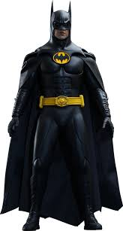
Pourquoi tombons-nous?
Nous tombons pour apprendre comment se lever.

Slide 5
Sommes-nous prêts?
Nous sommes prêts !

Slide 6
La première représentation du spectacle de LCHS, Anastasia, se passera demain à dix-neuf heures.

Slide 8
les taches ménagères

Slide 9
I know Jequivienne, the happy hippo.
You (familiar) know about organic chemistry.
Emily knows how to iron white shirts.
André and I know Mrs. Foulard, the woman who ate the fish.
You (formal) know how to write a funny story.
They know who has the worst toaster.

Slide 10
aérobique alphabet

Slide 12
Ma Belle Hippopotame

Slide 13
Jequivienne, une jeune hippopotame, est heureuse / triste parce que demain matin elle va __________
Write a play which is based on the phrase above. You may fill in the blank with any activity which you feel will make Jequivienne either happy or sad, but which does not involve any illegal activity.
Each person in the group must have at least three lines.

Slide 14
Devoirs

Slide 15
Billet de sortie
Write a sentence in which you say something to Jequivienne based on something you learned about her future from the play of another group.

