Slide 1
vendredi, le vingt-six avril

Slide 2
Travail de cloche
Écrivez, en mots, une équation mathématique qui termine aux mots “font vingt-six.”

Slide 3
vendredi, le vingt-six avril

Slide 4
Vendredi, vendredi
Rah, rah, rah!
Vendredi, Vendredi
On y va!

Slide 5
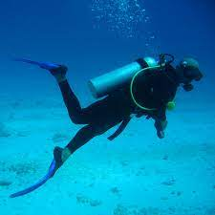
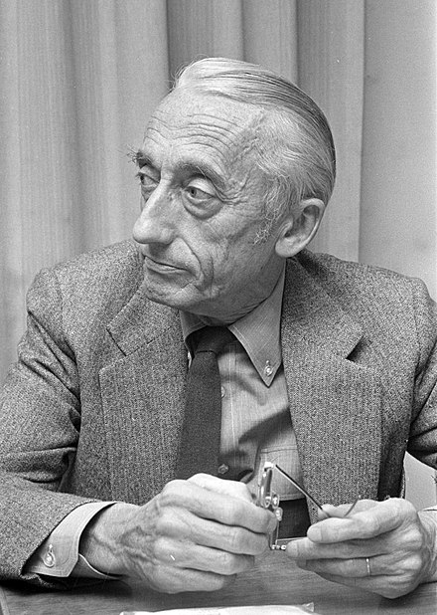
Jacques-Yves Cousteau (1910 – 1997) was a French oceanographer who was the co-inventer of the SCUBA and a pioneer of the production of videos of underwater life.

Slide 6
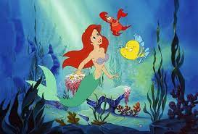

Slide 7
Avertissement!
Examen: Unité 7
vendredi, le trois mai

Slide 8
The two big dogs are yours. (formal)
We go to school on these horses, they are ours.
Although Lucie drinks a lot of milk, she is always thirsty.
In order that my grandson becomes a doctor, he studies biology in high school.
Unless you and your boyfriend have enough potatoes, you cannot feed the elephants.
Jean is the best poet that we know of who writes for the theater.

Slide 9
Devoirs

Slide 10
Billet de sortie
Écrivez une phrase qui parle de la dernière fin de semaine du mois d’avril.

