Slide 1
mardi, le trente avril

Slide 2
Travail de cloche
Translate into French: The one who reads the books of Dickens loves those who write about Molière .

Slide 3
mardi, le trente avril

Slide 4
examen
unité 7
vendredi, le trois mai

Slide 5
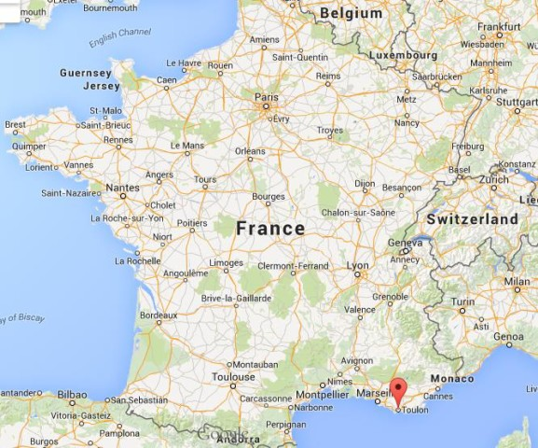
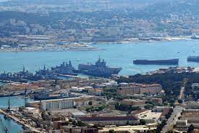
The largest naval base in France is located at Toulon.

Slide 7
Write five sentences which tell about the work of an artist / performer, either real or imaginary.

Slide 8
Pourquoi est Nettoitou le meilleur produit pour faire le ménage?

Slide 9
The cake at the festival of arts is mine.
The apple on the stage is yours (familiar)
The poems about happiness are his and the poems about death are theirs.
The two big dogs are yours. (formal)

Slide 10
Write a sentence which begins: There is nobody we know…
Write a sentence which uses the “ne explétif.”

Slide 11
Devoirs

Slide 12
Billet de sortie
Écivez une phrase qui s’agit de mardi.

