Slide 1
Bonjour!
jeudi, le cinq décembre

Slide 2
Travail de cloche
Translate into French: Bob and Carol were talking to each other when Ted and Alice met at the opera.

Slide 3
Bonjour!
jeudi, le cinq décembre

Slide 4
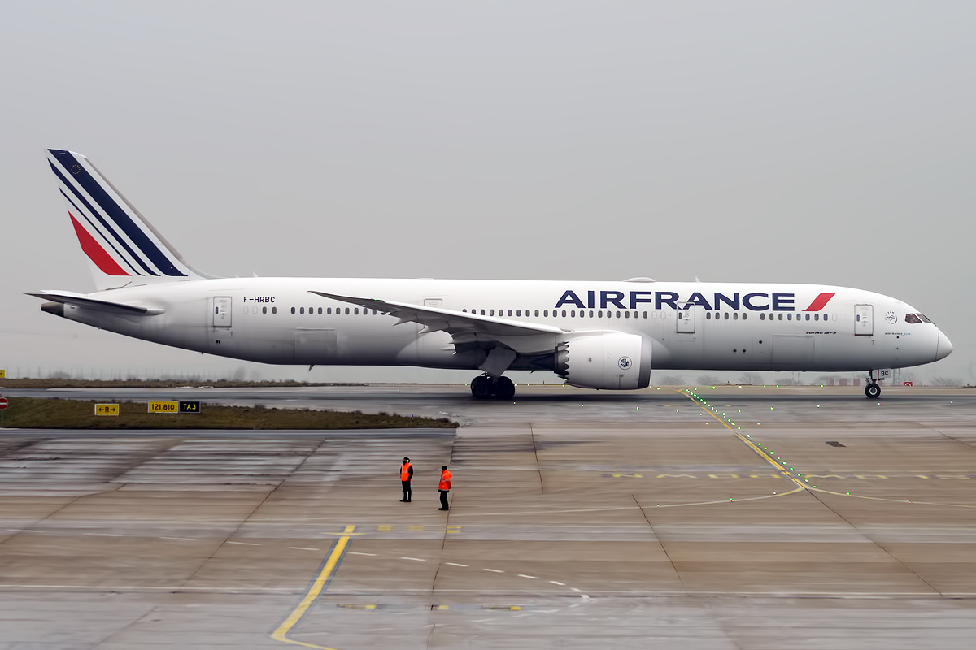
Air France flies to 175 cities in 78 countries throughout the world.

Slide 5
On va en vacances!

Slide 6
aérobique alphabet

Slide 8
Henri IV

Slide 9
Write a sentence of at least five words in the passé composé which uses the reciprocal reflexive indicated. You must use a different subject pronoun for each sentence.
se quitter
se retrouver
se téléphoner
se parler
s’embrasser _

Slide 10
Draw a car and indicate, in French, the words for seven parts of the car.

Slide 11
Devoirs

Slide 12
Billet de sortie
Answer with a complete sentence in French: What was the most interesting thing you learned today from the presentation of another student.

