Slide 1
Bonjour
jeudi, le douze décembre

Slide 2
Travail de cloche
Translate into French:
Why is Bob’s chicken under the desk, and where is the dog’s pencil?

Slide 3
Bonjour
jeudi, le douze décembre
un moment de culture francophone
révision
le vocabulaire

Slide 4
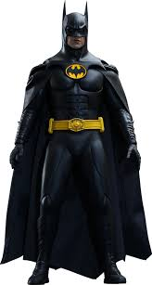
Pourquoi tombons-nous?
Nous tombons pour apprendre comment se lever.

Slide 5
Sommes-nous prêts?
Nous sommes prêts!

Slide 6
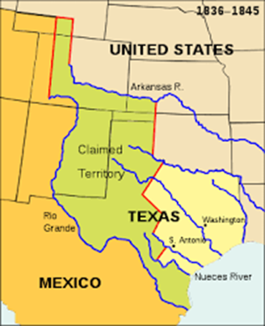
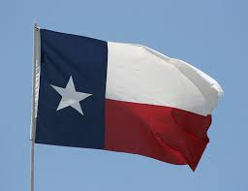
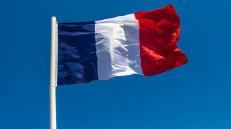
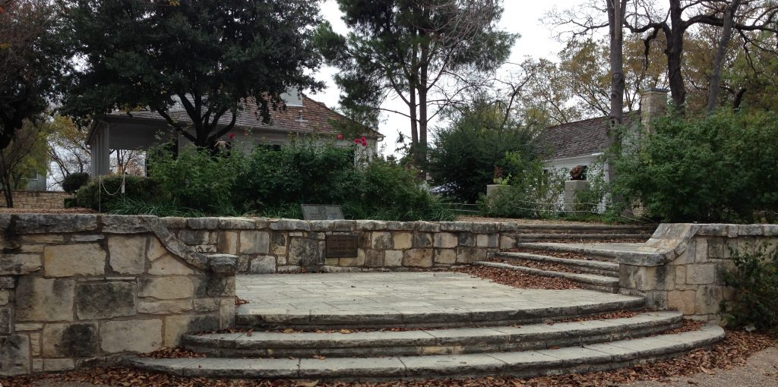
From 1836 -1845, when Texas was an independent republic, France was the only nation which maintained an embassy in Austin.

Slide 7
Unit 4 exam:
tomorrow, December 13.
The final exam, which will be cumulative, will be
Wednesday, December 18: 7:45 AM – 9:30 AM.
You are invited to study hall in this room (205A) from 2:00 – 2:45 Wednesday and Thursday.

Slide 8
un magasin pourquoi le sucre bavarder
coûter boire finir une piscine comment
le beurre dépenser une tasse aller obéir à
le parc combien patiner un morceau le prix
prendre choisir la place quand le jambon
nager un verre l’addition réussir l’hôpital

Slide 9
Write sentences of at least five words in French, each using the word in parentheses somewhere in the sentence. If the word is a verb it may be used in any proper conjugation or in the infinitive.
(la piscine)___________________________________________________________
(jouer)______________________________________________________________
(comment)__________________________________________________________
(le centre commercial)_________________________________________________
(finir)_______________________________________________________________

Slide 10
There will be no written homework due until January 7, 2025.

Slide 11
Étudiez!

Slide 12
Write a sentence in French which you hope will be the response to a prompt on the exam tomorrow.

