Slide 1
Bonjour!
lundi, le seize décembre

Slide 2
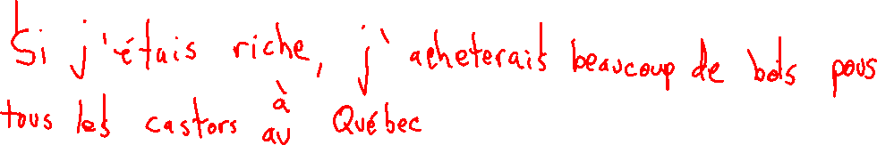
Translate into French: If I was rich I would buy a lot of wood for all of the beavers in Quebec.

Slide 3
Bonjour!
lundi, le seize décembre

Slide 4
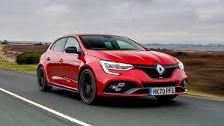
Renault is the best-selling brand of car in France.

Slide 5
The end is near!
The final exam, which will be comprehensive will be
Thursday, December 19, 12:10 – 1:50.
If you finish taking the test before the end of the test period, you will be allowed to go to another room only if you have a pass from a teacher.

Slide 6
les tabernaks
secret = secret
sacré = sacred, holy, blessed
le sacre = coronation, consecration, ritual
le sacre = cussword
Je déteste cette sacrée classe de français!
Le castor sacré prie à son barrage.
Le sacré castor a mangé mon poisson.

Slide 7
Write five sentences in the passé proche (venir de + infinitive): each having a different pronoun as its subject, and each describing something which happened at the stores of five different petit(e)s commerçant(e)s. Your action must be something which could reasonably be expected to have happened at such a place. You may only use the verb “acheter” once.

Slide 8
Write a sentence which describes someone or something using an adjective other than good or bad. Then write sentences describing how other people or things exhibit less and the least amount of the characteristic expressed by the adjective.

Slide 9
Write sentences which describe how three people do the same thing: one who does it well, one who does it better, and one who is the best at doing it.

Slide 10
Translate into French
The fortune teller offered to tell us if he discovered that the warning light did not work.
_________________________________________________________________________________
If the mechanic found the beaver in the trunk, we would suffer.
_________________________________________________________________________________
Open the hood and clean the windshield.
_________________________________________________________________________________
The headlights allowed us to see the lighthouse
_________________________________________________________________________________

Slide 11
Étudiez

Slide 12
Translate into French: We were suffering in the trunk of the baker’s car when a fish seller opened the door.

