Slide 1
Bonjour!
mardi, le vingt-cinq mars

Slide 2
Travail de cloche
Translate into French: Even though he is tall, Jacques can not play basketball.

Slide 3
Bonjour!
mardi, le vingt-cinq mars

Slide 4
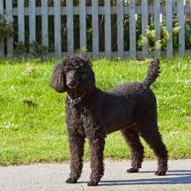
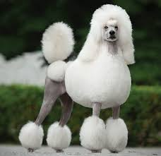
Le caniche est l’espèce de chien la plus populaire en France.

Slide 5
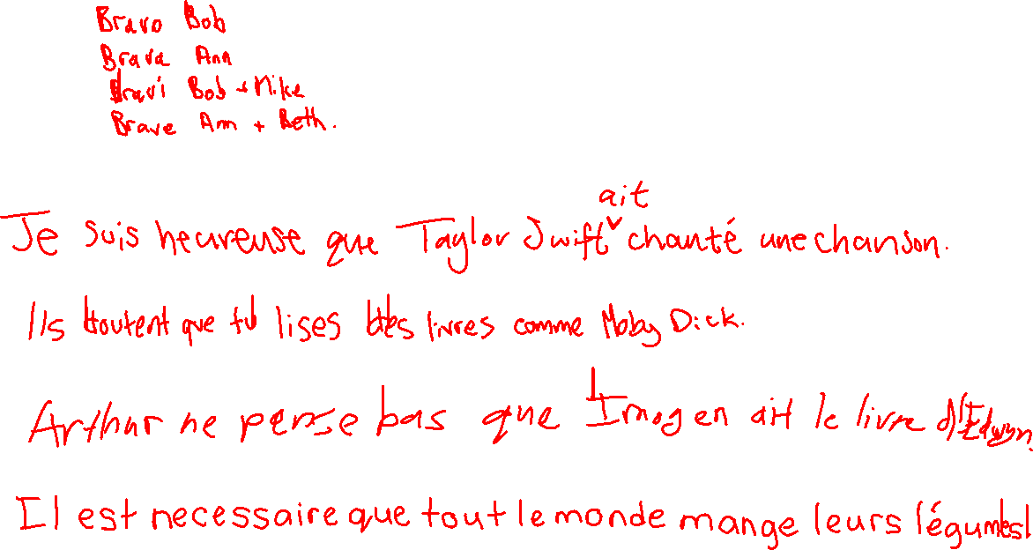
I am happy that Taylor Swift sang a song.
They doubt that you (familiar) read books like Moby Dick.
Arthur does not think that Imogen has Edwyn’s book.
It is necessary that everyone eats their vegetables.

Slide 6
Écoutez!

Slide 7
Écrivez!

Slide 8
Devoirs

Slide 9








Billet de sortie
Translate into French: I believe that Justin will buy a fish at lunch today. I doubt that Claude will come to the party.

