Slide 1
Bonjour!
mercredi, le vingt-six mars

Slide 2
Travail de cloche
Write a sentence which uses two different adverbs.
Notes:
é

Slide 3
Bonjour!
mardi, le vingt-six mars
un moment de culture francophone
le roman-photo
révision

Slide 4
Pourquoi tombons-nous?
Nous tombons pour apprendre comment se lever.

Slide 5
Sommes-nous prêts?
Nous sommes prêts !

Slide 6
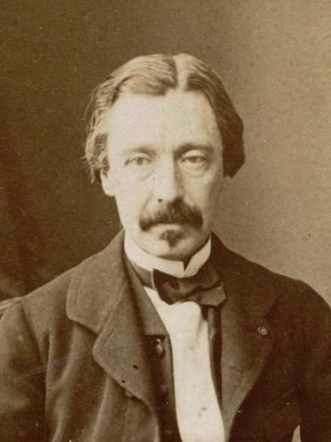
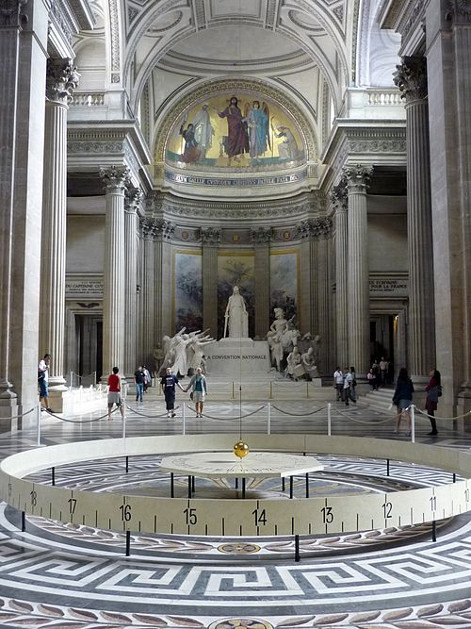
Léon Foucault was a French physicist who, in 1851, displayed a pendulum which can be used to demonstrate that the earth rotates around its axis.

Slide 7
roman-photo
pp. 288 - 289

Slide 8
aérobique alphabet

Slide 9
la musique
Ça fait rire les oiseaux

Slide 10
On parle français!!!

Slide 11
Carol was reading while Alice was writing.
We run rapidly at the park.
You and your mother often say “we like pineapples.”
It was raining when his plane arrived at the airport.
We wrote our letters to Santa Claus last Saturday

Slide 12
Devoirs

Slide 13
Billet de sortie
Translate into French: We walked to school, we entered the building, we heard the school song, we ran to class, we listened to the teacher.
Notes:
é

