Slide 1
Bonjour!
mardi, le trois mai

Slide 2
Travail de cloche
Translate into French: My library has more books than yours.

Slide 3
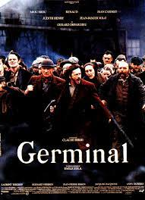
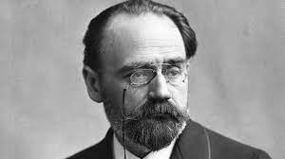
Germinal is a novel by Emile Zola which tells about a strike by French coal miners in the XIX century.

Slide 4
Bonjour!
lundi, le deux mai

Slide 5
Final Exam: Cumulative for Semester 2: Tuesday, May 17, 12:10 – 1:50
If you wish to go to another classroom after you finish the final exam, you must have a pass from another teacher before the test begins: i.e. you may not leave 206A to go to ask another teacher for a pass.
You are welcome to attend quiet study hall Tuesday and Wednesday 2:00 – 2:45 in Room 206A.

Slide 6
Le Grand Michu

Slide 7
Comment commence la revolte des élèves?
Les élèves, que mangent-ils pendant la revolte?
À fin que decide le proviseur?
Que chantent les élèves pour demontrer leur solidarité?
Comment finit la revolte?

Slide 8
Devoirs

Slide 9
Billet de sortie
Translate into French: Raul has as many friends as Bertrand.

