Slide 1
Bonjour!
jeudi, le douze mai

Slide 2
Travail de cloche
Translate into French: Their airplane was arriving when the apple fell.

Slide 3
Bonjour!
jeudi, le douze mai
un moment de culture francophone
la révision

Slide 4
Pourquoi tombons-nous?
Nous tombons pour apprendre comment se lever.

Slide 5
Sommes-nous prêts?
Nous sommes prêts !

Slide 6
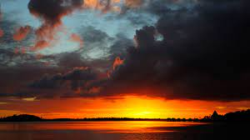
When it is 8:00 AM in Colorado it is 4:00 AM in French Polynesia

Slide 7
TOMORROW FRIDAY, MAY 13 EAGLE GAMES DAY
Come to 206A as usual at 7:45 AM
Attendance will be taken.
Points will be recorded for wearing house / order T-shirts
Proceed to the Colosseum for opening ceremonies.

Slide 8
Final Exam: Cumulative for Semester 2: Tuesday, May 17, 7:45 – 9:30
If you wish to go to another classroom after you finish the final exam, you must have a pass from another teacher before the test begins: i.e. you may not leave 206A to go to ask another teacher for a pass.
You are welcome to attend quiet study hall Tuesday and Wednesday 2:00 – 2:45 in Room 206A.

Slide 9
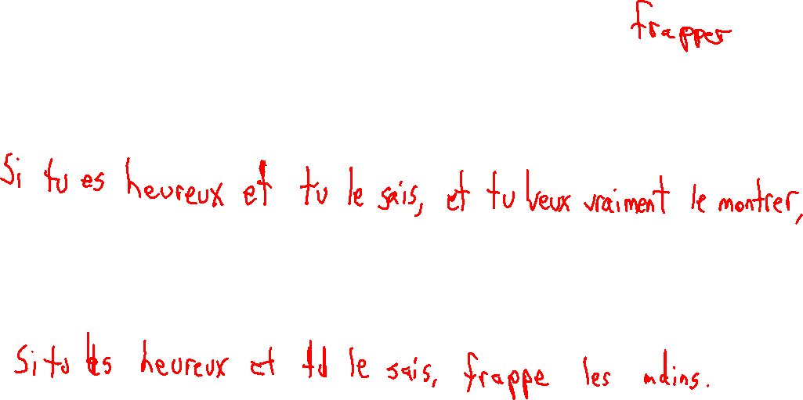
If you’re happy and you know it and you really want to show it, if you’re happy and you know it clap your hands.

Slide 10
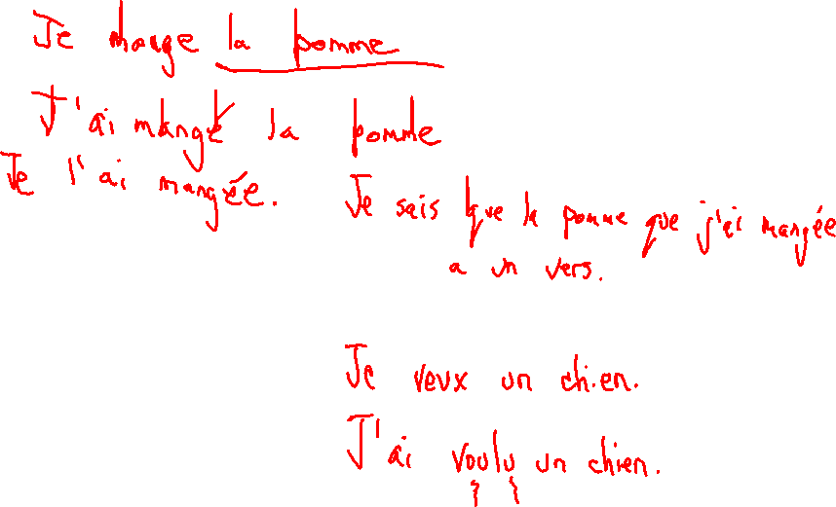
le passé compose with être
direct object pronouns
adverbes
dire, lire, écrire
l’imparfait

Slide 11
Devoirs
Monday, come prepared to ask questions concerning the final exam.

Slide 12
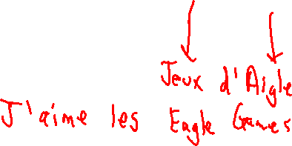
Billet de sortie
Write a sentence about Eagle Games.

