Slide 1
mercredi, le onze mai

Slide 2
Travail de cloche
À votre avis, comment va la fleur du Petit Prince après son absence ?

Slide 3
mercredi, le onze mai

Slide 4
Unit Exam: Le petit prince: tomorrow, Thursday, May 12, in class
Final Exam: Cumulative for Semester 2: Wednesday, May 18 9:40 – 11:20
Les Misérables, Le Comte de Monte Cristo, 20.000 Lieues sous les mers, Le Petit Prince
If you wish to go to another classroom after you finish the final exam, you must have a pass from another teacher before the test begins: i.e. you may not leave 206A to go to ask another teacher for a pass.
You are welcome to attend quiet study hall Tuesday and Wednesday 2:00 – 2:45 in Room 206A.

Slide 5
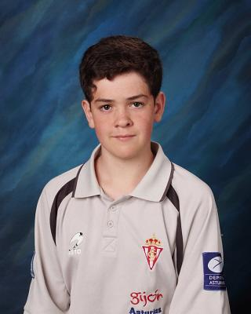
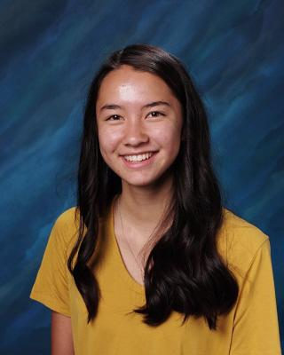
lundi

Slide 6
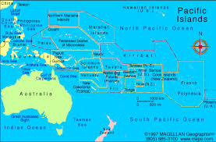
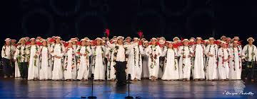
Himene tārava is a type of chorale music common to French Polynesia and the Cook Islands

Slide 8
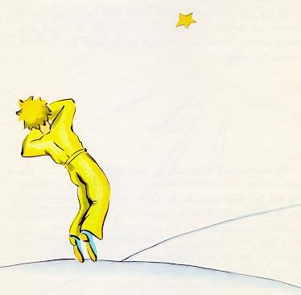

Slide 9
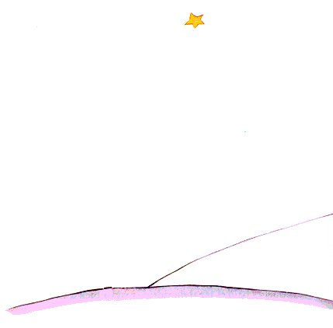

Slide 10
There is no written assignment for tomorrow.
Étudiez!

Slide 11
Billet de sortie
Qu’est-ce que vous avez à laquelle vous tenez comme le Petit Prince tient à sa fleur ?

