Slide 1
S’il vous plait, rendez vos devoirs. Please turn in your homework.
Travail de cloche
Write a masculine noun and a feminine noun with the appropriate definite article. This does not require a complete sentence.

Slide 2
Bonjour! Lesson 4: D’Accord pp. 10, 11, 14
jeudi, le vingt-cinq août
un moment de culture francophone
les noms
les articles
le genre des noms
The students will learn the importance of gender in French vocabulary.

Slide 3
Pourquoi tombons-nous?
Nous tombons pour apprendre comment se lever.

Slide 4
Sommes-nous prêts?
Nous sommes prêts !

Slide 5
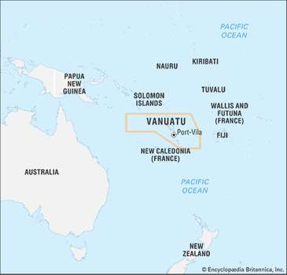
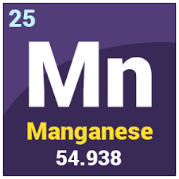
The independent francophone nation of Vanuatu, formerly the Condominium of the New Hebridies, is one of the worlds largest producers of manganese.

Slide 6
A noun
A person
A place
A thing
A concept
In French, nouns are gendered: i.e. they are referred to as being male or female. The assignment of nouns as being male or female is not based on any association with men or women except for a person’s name and words which describe familial relationships such as aunt or grandfather.

Slide 7
le, la, l’, les
un, une

Slide 8
1 un 11 onze 21 vingt-et-un
2 deux 12 douze 22 vingt-deux
3 trois 13 treize 23 vingt-trois
4 quatre 14 quatorze 24 vingt-quatre
5 cinq 15 quinze 25 vingt-cinq
six 16 seize 26 vingt-six
sept 17 dix-sept 27 vingt-sept
huit 18 dix-huit 28 vingt-huit
neuf 19 dix-neuf 29 vingt-neuf
dix 20 vingt 30 trente

Slide 9
Je pense d’un chiffre.
moins
plus

Slide 10
Devoirs

Slide 11
definite articles
indefinite articles

Slide 12
Billet de sortie
Combien d’élèves y a-t-il dans notre classe de français?

