Slide 1
mercredi, le cinq octobre

Slide 2
Travail de cloche
Ask a question which uses a tag phrase.

Slide 3
mercredi, le cinq octobre
un moment du culture francophone
Révisons!

Slide 4
Pourquoi tombons-nous?
Nous tombons pour apprendre comment se lever.

Slide 5
Sommes-nous prêts?
Nous sommes prêts !

Slide 6
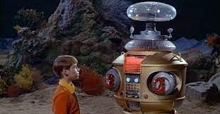
AVERTISSEMENT!
Exam: Unit 2
Friday, October 7
“ER” verbs, avoir, avoir idioms, telling time, vocabulary p. 88

Slide 7
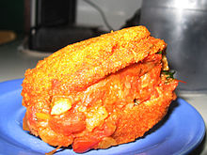
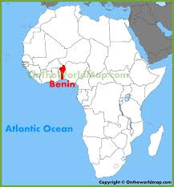
Acarajé, peeled black-eyed peas formed into a ball and then deep-fried, is a traditional dish in the francophone nation Benin.

Slide 8
p. 73
Every Monday I am scared of big dogs
You (familiar) wrong: chemistry is useful.
Pierre is in the mood to eat pizza.
We need three pens.

Slide 9
Every Friday, you (plural) are correct, three intelligent beavers are in the classroom.
Saturday, Tom and Bill appear to be happy.
Sunday, we share our pencils with our friends.

Slide 10
Use the dictionary to look up the French words for three animals which you might find in Loango Park.
Write three sentences, each of which uses an expression with avoir, one of the animals which you have chosen, and a regular “ER” verb from p. 54. Use the dictionary / wordreference to find words you do not know.
Speak to three classmates. For each one write what one of them said about a specific animal. You must get sentences which mention three different animals.

Slide 11
Devoirs

Slide 12
Billet de sortie
D’habitude, à quelle heure as-tu sommeil?

