Slide 1
Bonjour!
lundi, le dix octobre

Slide 2
Travail de cloche
Écrivez une phrase à la voix passive qui parle de Victor Hugo.

Slide 3
Bonjour!
lundi, le dix octobre

Slide 4
This week there will be non-block classes on Monday, Tuesday, and Wednesday.
There will be block day classes on Thursday and Friday.
Thus, we will have a regular class onWednesday, a block-day class on Thursday, and no class on Friday.
Emma will give her presentation on Thursday.

Slide 5
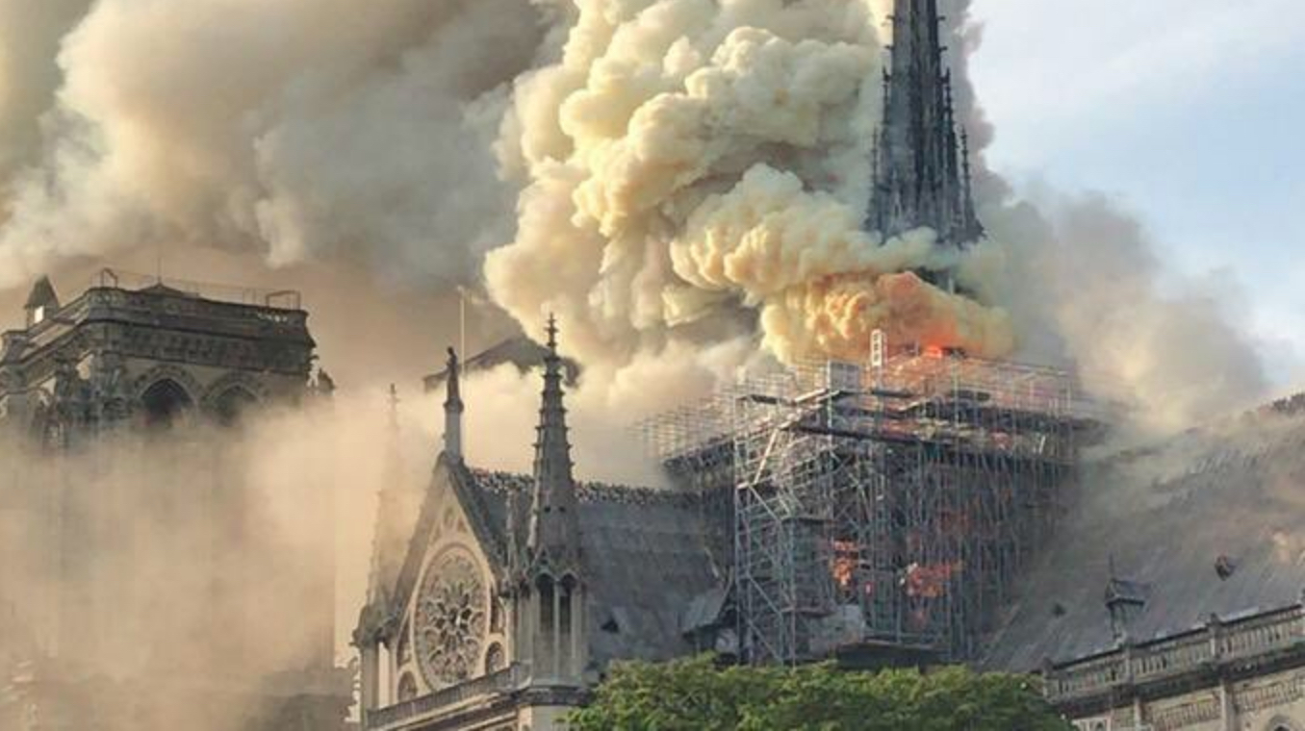
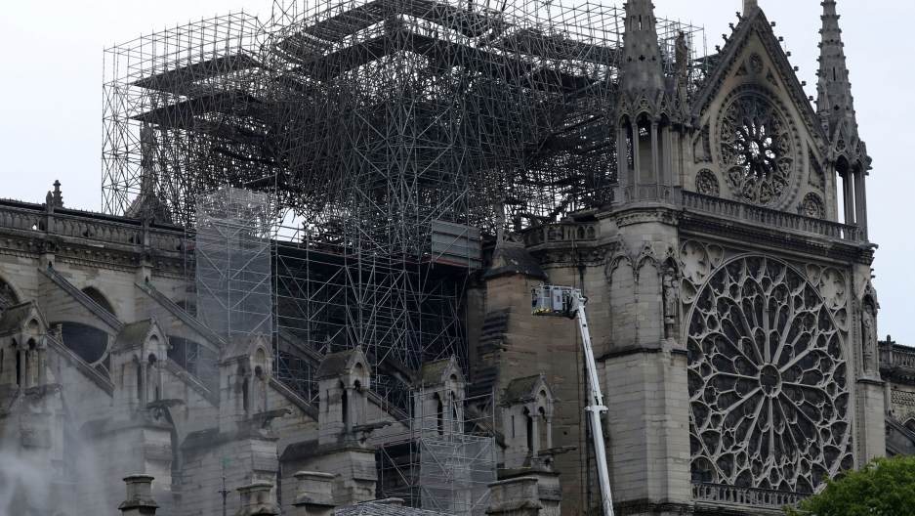
Un incendie le quinze avril 2019 a causé d'importants dégâts à la cathédrale de Notre Dame de Paris.

Slide 6
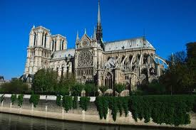
la cathedral de Notre Dame de Paris.

Slide 7
Victor Hugo

Slide 8
le houx vert
la bruyère en fleur

Slide 9
Billet de sortie
Translate into French: After having studied French grammar, my second exam was a great success.

