Slide 1
Bonjour!
mercredi, le douze octobre

Slide 2
Travail de cloche
Translate into French: Their cats are small. Our school is big. Her father is intelligent. His mother is forty years old.

Slide 3
Bonjour!
mercredi, le douze octobre
un moment de culture francophone
la révision
les adjectifs possessifs / les adjectifs descriptifs

Slide 4
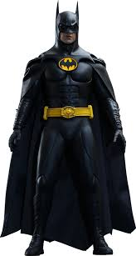
Pourquoi tombons-nous?
Nous tombons pour apprendre comment se lever.

Slide 5
Sommes-nous prêts?
Nous sommes prêts !

Slide 6
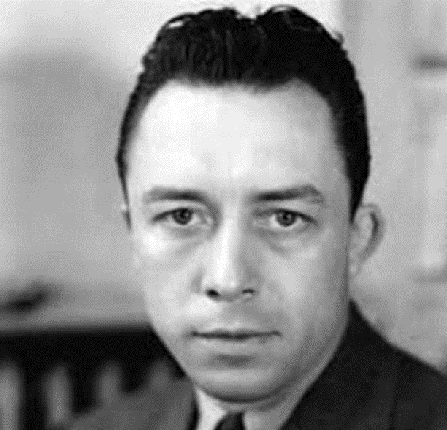
Albert Camus (1913 – 1960) was one of the pre-eminent writers of the twentieth century, winning the Nobel Prize for Literature in 1957. He was born in Algeria and many of his best known works are set there; always told from the point of view of the “pieds noirs”

Slide 7
Elle a les cheveux blonds
Elle est blonde
Il a les cheveux blonds
Il est blond

Slide 8
Elle a les cheveux rousses
Elle est rousse
Il a les cheveux roux
Il est roux

Slide 9
C’est Tatiana.
Elle est rousse.
Elle vient de Moscou.
Elle est russe.
Elle est russe rousse.

Slide 10
In French, possessive adjectives agree in number and gender with the noun to which they refer!!!
masculin féminin pluriel
1st person singular mon ma mes my
2nd person singular ton ta tes your
3rd person singular son sa ses his/her
1st person plural notre notre nos our
2nd person plural votre votre vos your
3rd person plural leur leur leurs their

Slide 11
ma, ta, and sa are never used immediately before a noun which begins with a vowel, thus
mon école
ton amie
son idée

Slide 12
Write three sentences following the form
My __(relative)__ is __(adjective 1)__ and __(adjective 2)__ .
Each sentence must use a different noun when speaking of your relative.
Read what has been written by three other members of the class. For each person write what they said about one relative. You must get information about three types of relatives.
Follow the format: Le / La __(relative)__ de __(name)__ is
__(adjective 1)__ and __(adjective 2)__ .

Slide 13
Je pense à quelqu’un. / Je pense à quelqu’une.
Est-il / Est-elle _______________?
A-t-il / A-t-elle _______________?

Slide 15
Devoirs

Slide 16
Billet de sortie
Translate into French: My aunt Louise is the sister of my father and my uncle Maurice is the brother of my mother.

