Slide 1
Bonjour
jeudi, le dix-sept novembre

Slide 2
Travail de cloche
Write a sentence which begins with an interrogatory word which concerns going to a café

Slide 3
Bonjour
jeudi, le dix-sept novembre
un moment de culture francophone
Le Québec
The students will be able speak about the province of Québec.

Slide 4
Pourquoi tombons-nous?
Nous tombons pour apprendre comment se lever.

Slide 5
Sommes-nous prêts?
Nous sommes prêts!

Slide 6
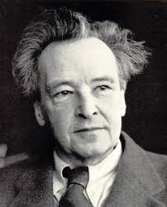
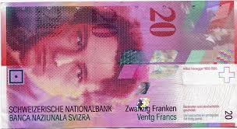
Arthur Honneger (1892 – 1955) was a Swiss composer whose compositions made use of both classical and modern elements.

Slide 7
Le Québec
pp. 170 - 171

Slide 8
Devoirs

Slide 9
Billet de sortie
Write a sentence about Québec.

