Slide 1
Bonjour
lundi, le vingt-huit novembre

Slide 2
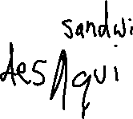
Travail de cloche
Write a sentence of at least five words in French which concerns eating in a café.

Slide 3
Bonjour
lundi, le vingt-huit novembre
un moment de culture francophone / americain
le vocabulaire

Slide 4
Pourquoi tombons-nous?
Nous tombons pour apprendre comment se lever.

Slide 5
Sommes-nous prêts?
Nous sommes prêts!

Slide 6
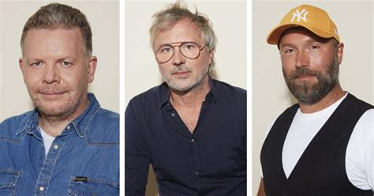
The Netflix animé series “Arcane” is directed by three French artists, Pascal Charrue , Jérôme Combe and Arnaud Delord.

Slide 7
On Thursday (December 1) you will present a café skit.
You will work in groups of four.
One person will be the server and the others will be diners.
The skit will be entirely in French
The server will greet the diners and show them to their seats and present them with a menu.
The diners will look at the menu.
The server will ask what the diners would like.
The diners will make their selection, which will include a main dish, a drink and a dessert.
The server will go “to the kitchen” and the diners will talk to each other.

Slide 8
The server will bring the orders and the diners will eat.
The server will check to see if everything is alright.
The diners will ask for the check, will pay, will say good-bye to the server, and depart.
The group will make a menu, which must be entirely in French, to be used as a prop during their presentation. Only one copy is needed.
The menu must give the name of the café and place it in a francophone city other than Paris.
The menu must have at least five main dishes, five drinks, and five desserts and prices for all items in the currency of the country where the café is located.

Slide 9
Reading from a script is acceptable, but part of the grade is dependent on whether speech seems natural or mechanical.
Each team member must speak at least four lines.
You will have all day tomorrow (Tuesday, November 29) and the first half of Thursday, December 1 (block day) to prepare your skit.
A perfect score for the café skit will be 600 points.

Slide 10
Jetez le castor!
Dites bonjour à Justin.
Dites-lui quelque chose de vos vacances.
Jetez le castor à quelqu’un d’autre.

Slide 11
Charades
les verbes “IR”

Slide 12
Pictionary
p. 176

Slide 13
Échanges
p. 163

Slide 14
p. 176
Subject pronoun verb preposition (dans la ville)

Slide 15
Devoirs

Slide 16
Billet de sortie
Write a sentence of at least five words, in French, using the verb apprendre.

