Slide 1
Bonjour!
mardi, le vingt-neuf novembre

Slide 2
Travail de cloche
Translate into French: If Justin ate fish, he would be a big beaver.

Slide 3
Bonjour!
mardi, le vingt-neuf novembre

Slide 4
On Wednesday, November 30, you will give a presentation about a trip to a francophone city other Paris.
The presentation must be given as either a PowerPoint or Google Doc.
The first slide must state the city which you plan to visit and tell approximately how far it is from Fort Collins.
The second slide must tell why you chose this city.
The third slide must tell where you intend to stay during your visit.
The fourth must mention a restaurant where you will eat one meal during your stay.
You must then show three places you will visit during your trip and you must then explain why you wish to visit there.

Slide 5
Each slide must have a picture which is appropriate to that which is being discussed.
You may read from notes, but part of your grade will be based on whether you give the impression of understanding what you are saying.
You must send your presentation to M. Gerson via e-mail by 7:45, on Wednesday, November 29.

Slide 6
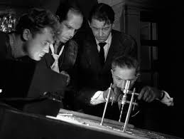
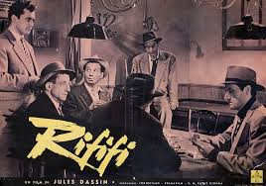
Rififi was a French film made in 1955 which concerned an attempted robbery of an upscale jewel store. It is famous for having a thirty-minute depiction of the robbery during which there was no dialogue or music.

Slide 7
Justin ouvre…
Justin a découvert…

Slide 8
Devoirs

Slide 9
Billet de sortie
Translate into French: We try to start to sing.

