Slide 1
Bonjour!
mardi, le six décembre

Slide 2
Travail de cloche
Write a sentence which indicates a condition for an action which discusses going skiing.

Slide 3
Bonjour!
mardi, le six décembre

Slide 4
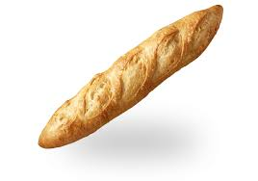
The French baguette has been added to UNESCO's 'intangible cultural heritage' list

Slide 5
The end is near!
There will be a unit exam on Friday, December 9.
The final exam, which will be comprehensive will be Wednesday, December 14 from 12:10 PM – 1:50 PM.
You are invited to study hall in this room (205A) from 2:00 – 2:45, Wednesday and Thursday.

Slide 6
Thomas et moi, souffrir, present
Tu, ouvrir, passé compseé
Jusitn et Céline, découvrir, imparfait
David, offrir, infinitive
Je, couvrir, futur proche

Slide 7
Justin souffre.

Slide 8
Pictionary
p. 202

Slide 9
Devoirs

Slide 10
Billet de sortie
Translate into French: Perhaps Sponge Bob’s pineapple would be moldy if it stays under the sea.

