Slide 1
Bonjour
jeudi, le huit décembre

Slide 2
Travail de cloche
Translate into French:
Why is Bob’s chicken under the desk, and where is the dog’s pencil?

Slide 3
Bonjour
jeudi, le huit décembre
un moment de culture francophone
révision
le vocabulaire

Slide 4
Pourquoi tombons-nous?
Nous tombons pour apprendre comment se lever.

Slide 5
Sommes-nous prêts?
Nous sommes prêts!

Slide 6
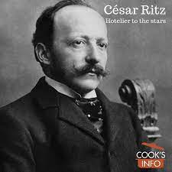
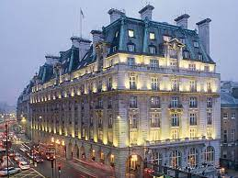
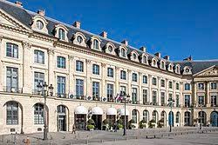
Cesar Ritz was a francophone Swiss hotelier whose eponymous Hôtel Ritz in Paris and in London were synonymous with elegance and attention to detail.

Slide 7
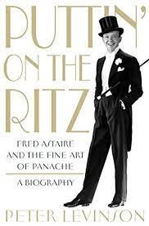
Thus, if a place, a person, or a gang member is said to be Ritzy, it means that they are very high class.

Slide 8
Unit 4 exam:
tomorrow, December 9.
The final exam, which will be cumulative, will be
Wednesday, December 15: 9:40 AM – 11:20 AM.
You are invited to study hall in this room (205A) from 2:00 – 2:45 Wednesday and Thursday.

Slide 9
un magasin pourquoi le sucre bavarder
coûter boire finir une piscine comment
le beurre dépenser une tasse aller obéir à
le parc combien patiner un morceau le prix
prendre choisir la place quand le jambon
nager un verre l’addition réussir l’hôpital

Slide 10
Write sentences of at least five words, in French, using the verbs indicated in You must use a different subject pronoun for each sentence.
grossir
choisir
grandir
obéir à
finir

Slide 11
There will be no written homework due until January 10, 2023.

Slide 12
Étudiez!

Slide 13
Billet de sortie
Write a sentence of at least five words which uses the word “combien.”

