Slide 1
Bonjour!
mardi, le treize décembre

Slide 2
Écrivez une phrase qui parle d’une autre école que LCHS.

Slide 3
Bonjour!
mardi, le treize décembre

Slide 4
The final exam, which will be cumulative, will be
Thursday, December 15: 9:40 – 11:20.
If you finish taking the test before the end of the test period, you will be allowed to go to another room only if you have a pass from a teacher.

Slide 5
C’est le drapeau du pays francophone Madagascar, où se trouve les aye-ayes.

Slide 6
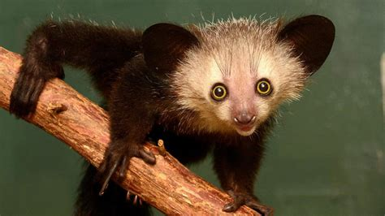

Slide 7
Alain L’Éponge, the father of Bob, had made a large fortune in California, and then he sold his squids to the Comte de Chagny.
The singers from Austria will speak at noon. After they will have performed the opera (which will begin at 1 PM) they will eat dinner at 7:00 PM with Mr. Lovely.
Jacques Plante will make everyone buy hockey pucks.
A great novel was written in Monroeville.
After having written her novel, Jane sang a song which nobody heard.
M. Dubois would have given a horse to Gwen, but he thought she did not like them.
After having entered LCHS, Tom was cold.
Even though they make beautiful curtains, the sisters have none.

Slide 8
À bientôt!

Slide 9
Écrivez une ou deux phrases qui expriment vos pensées à la fin du semestre.

