Slide 1
Bonjour!
French 1
mardi, le dix janvier

Slide 2
Travail de cloche
Translate into French: I rarely sing songs by “Panic! At the Disco.”

Slide 3
Bonjour!
mardi, le dix janvier
un moment de culture francophone
faire
il faut
The students will be able to conjugate the verb faire and understand the use of the expression « il faut »

Slide 4
Pourquoi tombons-nous?
Nous tombons pour apprendre comment se lever.

Slide 5
Sommes-nous prêts?
Nous sommes prêts !

Slide 6
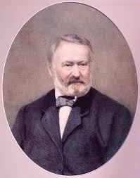
Victor Hugo was a XIX century French writer of novels, plays, and poetry. He also spoke forcefully in support of liberty and against tyranny, resulting in his exile during the reign of Napoleon III. Throughout France there are streets named in his honor.

Slide 7
pp. 186 - 187
faire
to do, to make
je fais
tu fais
elle fait
nous faisons
vous faites
ils font
Nous faisons nos devoirs après la classe est finie.

Slide 8
il faut
one must
falloir
to be obliged to
Falloir is only conjugated in the third person singular, and is always followed by a verb in the infinitive. The subject pronoun for falloir is always the impersonal “il.”

Slide 9
Il faut obéir à maman.
The negative of “il faut”, “il ne faut pas” can be thought of as meaning “one must not.”
Il ne faut pas laver ton hippopotame dans la piscine de l’hôtel.
If you wish to say that something is not required, but is permissible, the expression which is used is “il n’est pas nécessaire de…”
Il n’est pas nécessaire de rire à la plaisanterie ringarde du jour.

Slide 10
pp. 186 - 187
souvent
parfois
rarement
jamais

Slide 11
pp. 178 - 179

Slide 12
Écrivez un loisir que vous faites souvent,
un loisir que vous faites parfois,
un loisir que vous faites rarement,
un loisir que vous ne faites jamais.

Slide 13
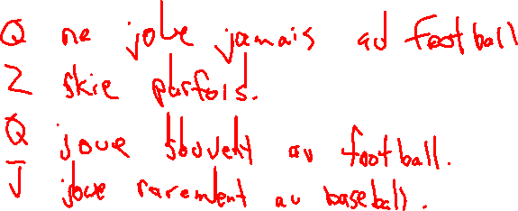
Speak to the other class members
Write down what one person does frequently, what one does occasionally, what one does rarely, and what one never does.

Slide 15
Devoirs

Slide 16
Billet de sortie
Write a sentence which uses “il faut.”
Write a sentence which uses “il ne faut pas.”
Write a sentence which uses a properly conjugated form of the verb “faire.”

